Slide 1
Phonics and Early Reading
Information Session
Notes:
Welcome to the session. We are really pleased to get together to share further information about the teaching of phonics and early reading, and are very grateful for your time and support. Reading is one of the most important things we can teach our children. We want all our children to be avid readers with a love for all different types of literature.

Slide 2
We love reading!
Reading for pleasure
Finding out information
Reading the world around them
Understanding forms and official documents
Accessing learning
Notes:
We read for many different purposes…
In EYFS and KS1, pupils are very much focused on learning to read. As they move higher up the school and into secondary education and beyond they will be reading to learn. So it is vitally important that we support our youngest pupils to quickly learn to read. We want every child to love reading and to do this we must make sure that it is a pleasurable experience and that they can read with accuracy and fluency so they can access as many opportunities as possible.
Over the past 50 years schools have taught children to read using lots of different approaches. But, thanks to research we know that systematic synthetic phonics is the best way to teach children to read. We know this might be different to how you were taught to read so we hope this session supports your understanding of what phonics is, how phonics is taught at GV and how you can best support your child with reading at home.
We use the Department for Education validated scheme, Unlocking Letters and Sounds. All children in the school will use Unlocking Letters and Sounds to teach their phonics and early reading. All staff have had training with this scheme so they are experts at using it.

Slide 3
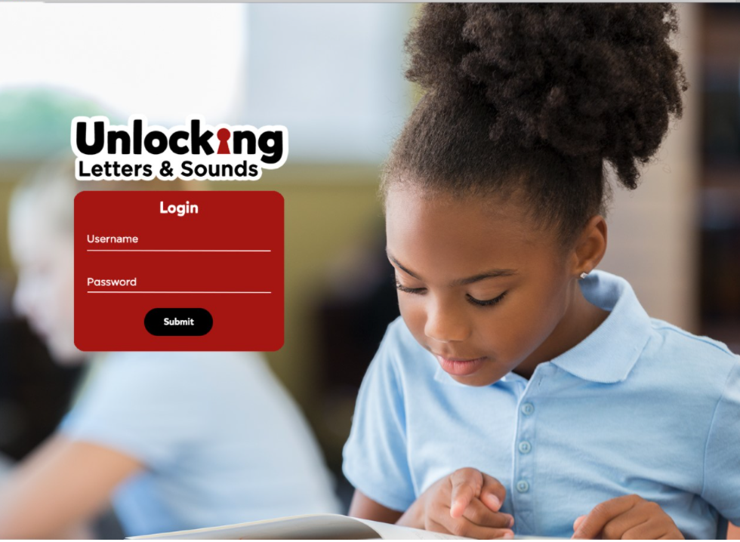

What is Phonics?
Link between the words we say and the letters that represent each sound.
Grapheme – the written letter or groups of letters
Phoneme – the sound that the grapheme makes.
Notes:
Quick reminder: Phonics teaches the link between the words we read/say and the words we write on the page. It teaches how the letters in written words represent the sounds we say in spoken words – this is called decoding.
Say the word FARM
When we say this word we say lots of sounds very quickly – so quickly we hardly notice the sound each letter makes.
Say the sounds in FARM f-ar-m
What sounds can we hear? When we write the word farm we represent each sound with a letter or a sequence of letters.
This is phonics!
There is some technical vocabulary that we use for phonics and that your children will use.
Grapheme – the written letter or groups of letters
Phoneme – the sounds that the grapheme makes.
With your new vocabulary can you tell me the phonemes that make this word - CHIPS
Can you tell me the graphemes that represent these phonemes?
As well as learning to recognise the graphemes and say the phonemes they represent we will be teaching children how to use these to read.

Slide 4

Blending
Pushing the phonemes together to make a word.
Starlight
Crepusular
Notes:
When we read a word we look at each grapheme and match a sound to it. We push the sounds together to make a word. This is called BLENDING. Blending is a really important skill that children need lots of practice at – it will take lots of time!
Let’s have a go at blending a word:
We teach the children to work from left to right - identifying each grapheme and saying the phoneme. Once they have done that they go back and push the phonemes together to blend and read the word.
We want to teach children to recognise the grapheme quickly so they can blend it rapidly. Once they can do this their reading will become fluent. But this really does take a huge amount of practice so it is really important that children practice this at home with the books we give them.
As children progress in their reading journey they will begin to read longer words made up of multiple syllables – give the example of starlight
We teach these words by ‘chunking’ them into syllables and blending these chunks together – /s-t-ar/ ‘star’ /l-igh-t/ ‘light’ ‘starlight’. But we are still identifying the GPCs and blending them together.
This is what we will do as adults when we come across an unfamiliar word – use the example crepuscular. How would we read this unfamiliar word? We would chunk it and blend the syllables together. This is why it’s really important to teach children to read using phonics – without this skills to decode the graphemes we would not be able to read unfamiliar words.
We know that when children are reading they are decoding the letter-sound correspondences they know and blending them together to read a word or group of words.
*To support pupils’ successful blending, it’s important to say each sound as a short, pure sound – /c-a-t/ ‘cat’ as opposed to /cuh-ah-tuh/ - when we add an /uh/ to a unit of spoken sound, this is called a shwah – it’s a very natural thing to do but it impedes pupils’ blending.

Slide 5

Spelling
Segmenting words
Daily writing as part of phonics lessons
Notes:
We teach children to use this same knowledge, but in reverse, to spell. Instead of blending the phonemes together to read a word we separate the phonemes so we can hear each sound to be able to spell the word. This is called segmenting.
Let’s try segmenting this word to write it: sh-i-p
Your child will write words, captions and sentences as part of their phonics lesson each day. As with reading, we will only ask them to write words contacting GPCs they have been taught. As part of their daily lesson we will also teach them how to write using the newly taught GPC and their prior phonics knowledge.
We’re aiming for automaticity in decoding & fluency in spelling and writing using phonic knowledge.

Slide 6
The Alphabetic Code
44 phonemes
Simple Code
Complex Code
Notes:
The English language is made up of about 44 different sounds represented with around 250 graphemes/letter or sequence of letters– which makes it one of the most complicated languages. It will take most children about three years to learn the alphabetic code and apply this knowledge to reading; it is one of the most important things we teach in Reception and Key Stage 1.
As your children continue to learn to read the alphabetic code will become more complex. They will learn about sounds that are represented by lots of different graphemes and how some graphemes can represent different sounds. The complexity of the English alphabetic code is why it takes so long to read. Many children will find different parts challenging – especially at first. But the staff at GV are skilled at teaching phonics and will be gradually working through the alphabetic code so that every child become an expert reader.

Slide 7
Further communication
Notes:
If your child is receiving additional practice to secure their phonics and CEW knowledge in school, we will communicate this with you via a letter updating you on their progress. This letter will let you know the focus GPC & CEWs your child is currently working on. One quick win way that you can support with this is by writing this GPC on a piece of paper and sticking it up on a door for your child to use as a password whenever they walk through the door. Look out for these in your child’s book bag! Your child’s class teacher will tell you more about this at parents’ evening.

Slide 8
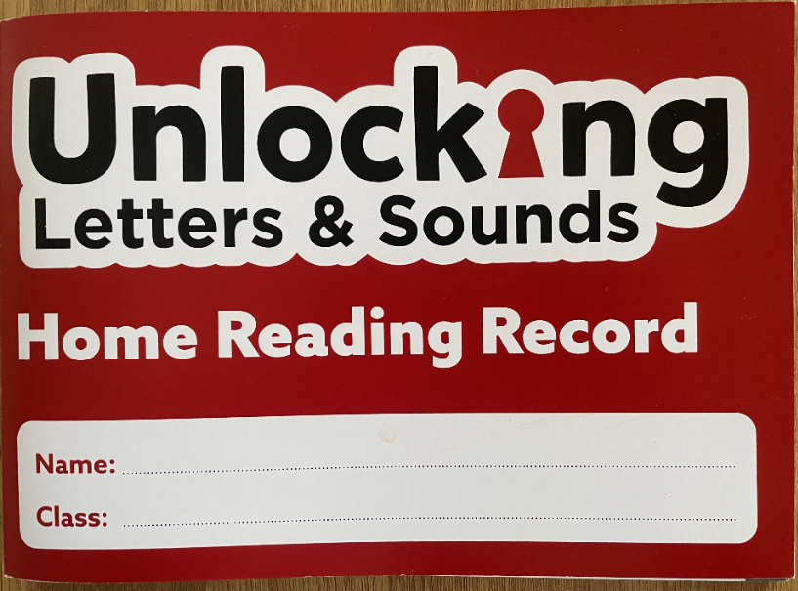
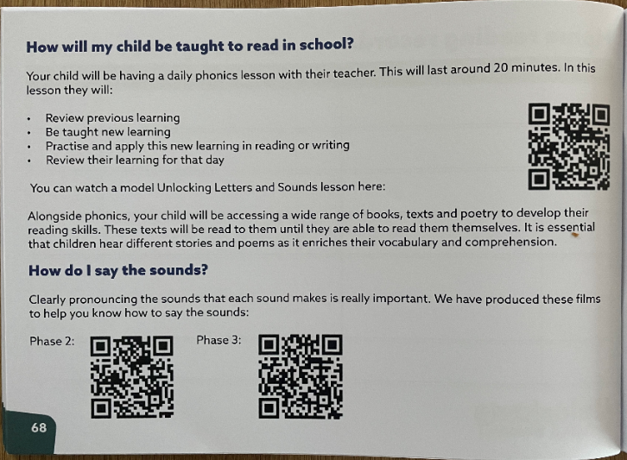
Notes:
We have purchased some brand new Unlocking Letters and Sounds Home Reading Records as these contain specific guidance about the ULS programme & useful resource links so that you know how to best support at home. On page 68 of the reading record, you’ll find a QR code which will take you to a video of a phonics lesson in action. Here, you’ll be able to see what a phonics lesson looks like. Your children are taught phonics daily until part-way through Y2. By watching the lesson video, you’ll be able to see the strategies used to support decoding and reading, and encoding and spelling everyday. There are also QR codes which will link you to videos of the phase 2 and phase 3 sounds being pronounced whilst the corresponding actions are acted out. On page 70, you’ll find a glossary with the key phonics vocabulary and their definitions.

Slide 9
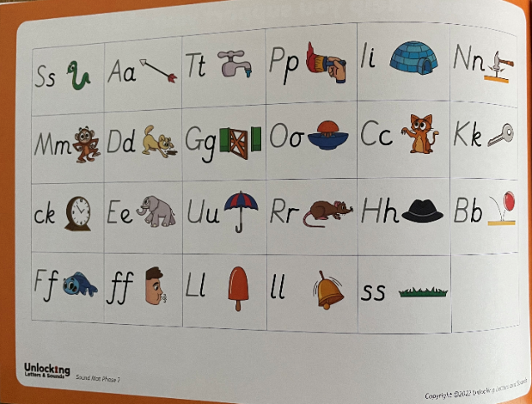
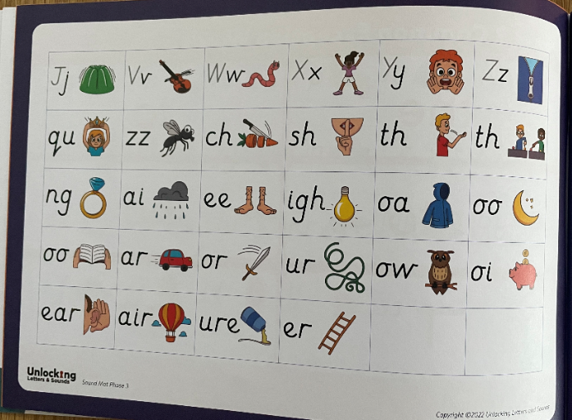
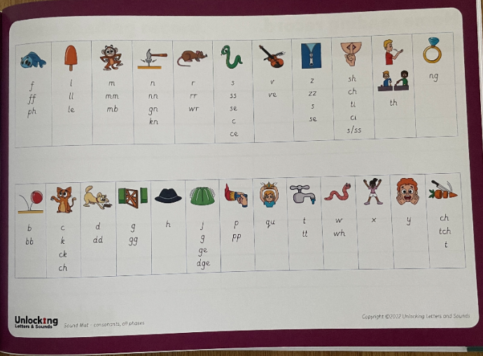
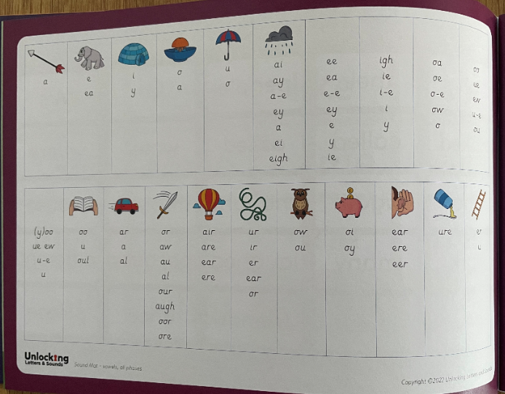
Notes:
Within the new reading records, you’ll also find the ULS sound mats. Your child will be familiar with using these to support their writing in school. So, if you’re child is doing any writing at home, use this resource to support them.

Slide 10

Reading and Books
Children will be given books when they can blend – this will be different for every child
Books precisely match children’s phonics attainment
Notes:
As soon as your child can blend some GPCs together to read words we will be giving them a book. This is incredibly exciting but will be different for every child. Some learn this skill very quickly and others take a bit longer – we will be supporting every child to blend as quickly as possible. Please don’t compare your child with others and contact us if you are worried about anything.

Slide 11
Reading at home
5 – 10 minutes
Choose a time that works for you
Be positive and celebrate successes
Encourage them to point to the graphemes
Encourage them to say the sounds and blend them together
Be patient and let them try and work it out
Read common exception words by sight.
Notes:
Reading at home is essential as it gives children the opportunity to practice their decoding and blending skills.
We know everyone is busy and children often don’t want to read out of schools. Our top tips are:
5 – 10 minutes every day is often more effective than longer times
Find a time that works for you. Reading at bed time sounds lovely but with a tired child it can often be tricky!
Celebrate what your child can do and
Encourage your child to point at the graphemes as they read – this helps them to track the words and know their place
Encourage them to say all the sounds in the words and then blend them together – you can show them how to do this.
Be patient and give them time to work it out before stepping in before stepping in If they can’t read a word model how to do it and then ask them to do it.
Let them read common exception words by sight.
One of the most important ways to increase children’s accuracy, fluency and understanding of the book they are reading is to re-read the same books several times. This is why your child will be allocated one matched text per week. On page 3 in your child’s new reading record, you’ll find a QR code which links you to a video modelling what multiple reads might look like. The film explains the value of re- reading the same book: https://www.youtube.com/watch?v=Hhu3xeNq3Kg&t=200s – class teachers will be checking reading records on your child’s guided reading day and will be awarding a house point if 3 or more reads are noted.

Slide 12
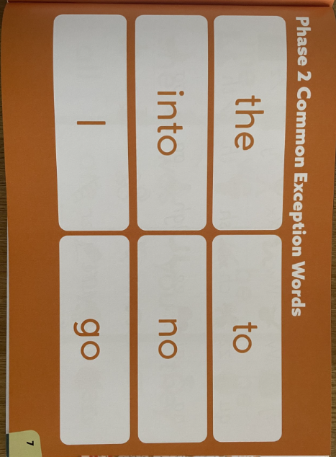
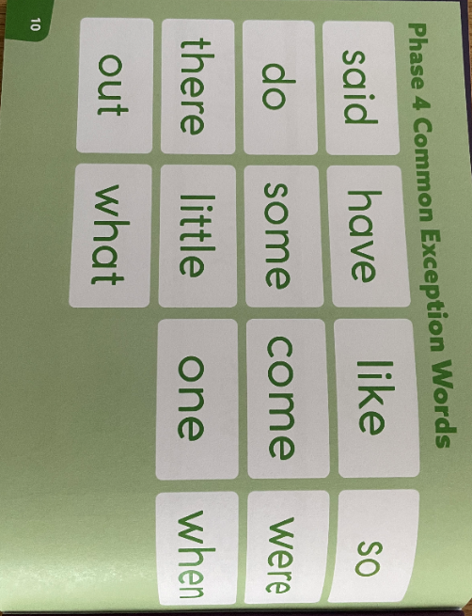
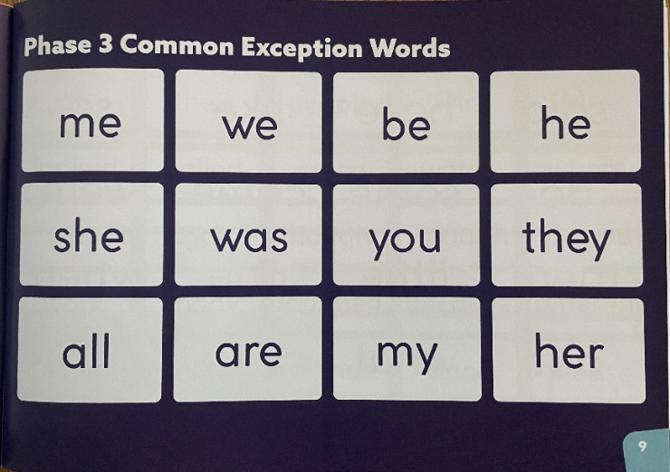
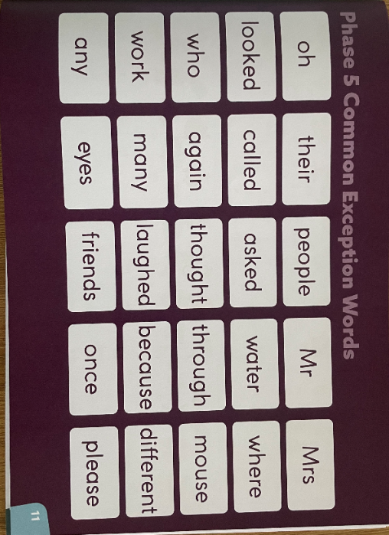
Common Exception Words
Notes:
A common exception word is a word which we can’t sound out using phonics, these are common words in the English language that we must learn to read by sight. Your child will have been taught phase 2, 3 and 4 CEWs throughout Reception and there are opportunities within phonics lessons to revisit these. In Y1, pupils will learn the phase 5 CEWs. When teaching CEWs, we show the children the word and tell them what it says, we then ask them to spot the phonics clue/s and the tricky part/s. So that you know which CEWs are gaps for your child, teachers will be ticking or highlighting CEWs that your child is secure in in their new reading record. You’ll then know that the gaps are the CEWs not highlighted/ticked.

Slide 13
Reading at home
Continue to read to your child.
Model how to read a book – left to right, turning pages
Ask questions about what has happened and characters’ feelings
Support vocabulary
Predict what will happen next
Make connections
Model your love of reading!
Notes:
Whilst learning to decode and reading fully decodable books to develop accuracy, automaticity and fluency is important, there is so much more to reading! We know that decodable books are not the most exciting to read and alone, won’t give our early readers all the skills they need to develop a love of reading.
It is therefore important that you continue to read to your child and share a wide range of books with them – these should be books that children cannot decode themselves. Reading books to children is a precious and lovely thing to do – we are sure you and your child already have favourite books that you share together! By modelling reading and show how much you love reading you will be setting a fantastic example to your child.
When you read to your child you will want to:
Model how to read a book
Ask questions about what has happened to support your child’s comprehension or understanding of the text
Ask questions about characters’ feelings
Discuss the meaning of words and vocabulary
Ask children to predict what they think will happen next
Make connections with things your child has experienced or other books or films they have seen – this informal book chat is vital for fostering children’s intrinsic motivation to read.
Most importantly – show that you love reading! By modelling this you will support your child to develop their love of reading.

Slide 14
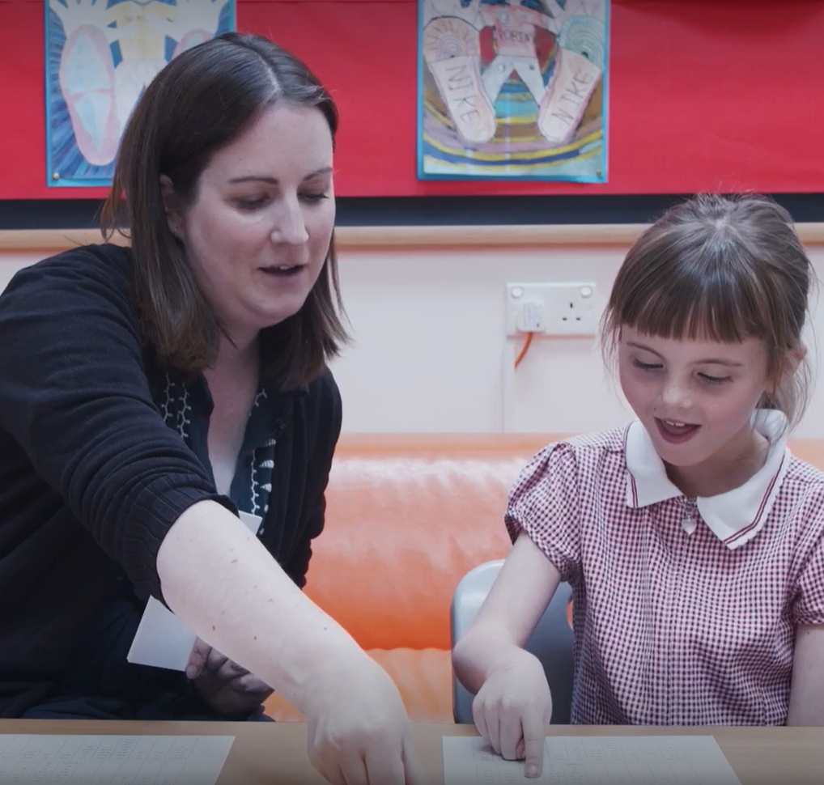
Concerns about progress
All children are different
Discuss any concerns with teachers
Teachers will assess your child reguarly
Interventions to support child in the specific skill they are struggling with
Adaptions for children with SEND
Notes:
All children are different and, at different points in their learning, will find things more difficult or challenging. Staff at our school have all had training to identify what children are finding difficult and to help them overcome this. We know it is very tempting to compare your child to others – especially with reading and what books they are on etc but we would suggest you speak to teachers if you have any concerns. If we have any concerns we will discuss them with you.
Teachers and TAs will assess your child regularly to check their learning. We quickly identify any child who might be at risk of falling behind and will support them with extra phonics- usually by giving them ‘interventions’ to support the specific skill they are struggling with – some children may struggle to identify the GPC, others might not be able to blend yet.
If a child has SEND we may need to make adaptions to their phonics e.g. additional time to practice, more visuals. Again we will discuss these with you but research has shown that phonics is the most effective way of teaching children with SEND to read.

Slide 15
Questions

