Slide 1

Golden Valley Primary School
Maths Information Evening
21.11.24

Slide 2
Maths EYFS – Y6 Parent Information
Teaching for Mastery approach.
How do we teach Maths at GV?
Typical Lesson.
Assessment.
Promoting a positive attitude.
How can I help at home?

Slide 3
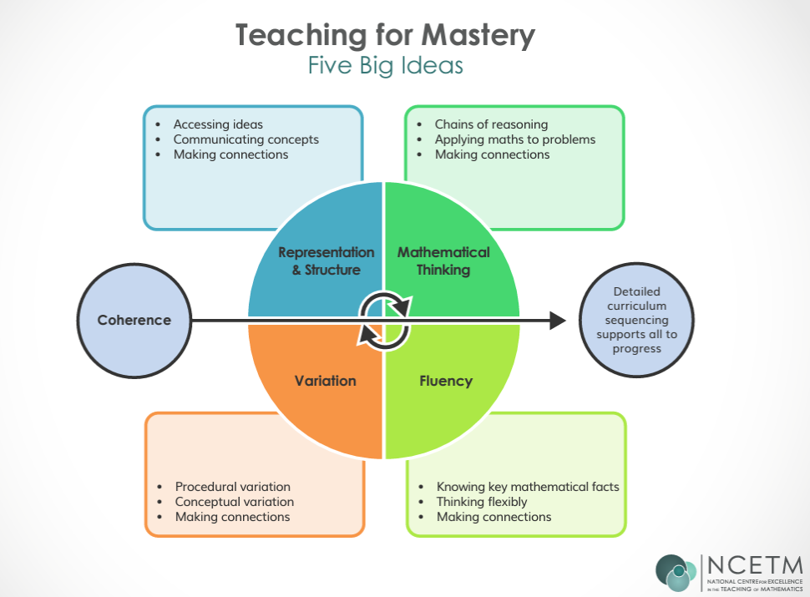

Slide 4
Coherence
Teaching is designed to enable a coherent learning progression through the curriculum, providing access for all pupils to develop a deep and connected understanding of mathematics that they can apply and communicate in a range of contexts.
Representation and Structure
Teachers carefully select representations of mathematics to expose mathematical structure. The intention is to support pupils in ‘seeing’ the mathematics, rather than using the representation as a tool to ‘do’ the mathematics. These representations become mental images that students can use to think about and discuss mathematics, supporting them to achieve a deep understanding of mathematical structures and connections.

Slide 5
Mathematical Thinking
Mathematical Thinking is central to how pupils learn mathematics and includes looking for patterns and relationships, making connections, conjecturing, reasoning, and generalising. Pupils should actively engage in mathematical thinking in all lessons, discussing and communicating their ideas using precise mathematical language.
Fluency
Efficient, accurate recall of key number facts and procedures is essential for fluency, freeing pupils’ minds to think deeply about concepts and problems, but fluency demands more than this. It requires pupils to have the flexibility to move between different contexts and representations of mathematics, to recognise relationships and make connections, to explain their ideas and to choose appropriate methods and strategies to solve problems.

Slide 6
Variation
The purpose of variation is to draw closer attention to a key feature of a mathematical concept or structure through varying some elements while keeping others constant. Through variation the teacher focuses thinking and discussion on the key feature in question.
Conceptual variation involves varying how a concept is represented to draw attention to critical features. Often more than one representation is required to look at the concept from different perspectives and gain comprehensive knowledge.
Procedural variation considers how the student will ‘proceed’ through a learning sequence. Purposeful changes are made in order that pupils’ attention is drawn to key features of the mathematics, scaffolding students’ thinking to enable them to reason logically and make connections.

Slide 7
What are we doing at GV?
At GV, we follow a Teaching for Mastery Approach and use White Rose Maths to underpin our mathematics curriculum as it provides an ambitious, connected curriculum that is accessible to all pupils and has a clear progression through the primary years and beyond.
At the heart of our curriculum is a commitment to develop resilience, confidence and self-belief; enabling our children to become fluent in the fundamentals of mathematics as well as develop their ability to reason and solve problems. Pupils are introduced to new mathematical concepts and develop reasoning and problem solving skills using concrete resources; pictorial representations and finally numbers and symbols.

Slide 8
We use the CPA (Concrete, Pictorial and Abstract) approach to help pupils understand mathematics and make links in their learning. We place great importance on mathematical language and questioning so pupils can discuss their understanding and develop their thinking.
WRM provides teachers with blocked units covering the curriculum.
The WRM blocks are further broken down into small steps.
WRM lessons will promote fluency, reasoning and problem solving.

Slide 9
Our intent is that…
Children will develop a sense of enjoyment and curiosity about all aspects of mathematics.
Children will become fluent in the fundamentals of mathematics, reason mathematically and solve problems by applying their skills and knowledge.
Children have an understanding that maths is essential to everyday life.

Slide 10
Our intent focuses on equipping all pupils with the mathematics they need to master the curriculum for each year group, which requires that all pupils:
recall number facts with speed and accuracy and use them to calculate and work out unknown facts.
develop their ability to apply mathematical skills with confidence and understanding when solving problems.
apply their mathematics to a variety of routine and non-routine problems with increasing sophistication, including breaking down problems into a series of simpler steps and persevering in seeking solutions.
express themselves and their ideas using the language of mathematics with assurance.
have sufficient depth of knowledge and understanding to reason and explain mathematical concepts and procedures and use them to solve a variety of problems.
develop positive attitudes to mathematics, recognising that mathematics can be both useful and enjoyable.
nurture a fascination and excitement of mathematics.
are able to use and apply the skills in other curricular areas.

Slide 11
What does a Maths lesson looks like?
A daily mathematics lesson of 45-60 minutes is taught in Year 1 – Year 6.
In EYFS pupils experience daily mathematics learning through whole class teacher input; teacher directed tasks and child-initiated play. Opportunities for mathematics is developed through daily routines and all areas of learning.
Children in EYFS and KS1 participate in the ‘Mastering Number @Reception and KS1’ project. This aims to secure firm foundations in the development of good number sense for all children from Reception through to Year 1 and Year 2. The aim is that children will leave KS1 with fluency in calculation and a confidence and flexibility with number. Attention will be given to key knowledge and understanding needed in Reception classes, and progression through KS1 to support success in the future.
MN Video

Slide 12

Children in Y4 and Y5 participate in the ‘Mastering Number @ KS2’ project. Knowledge of multiplication and division and its applications forms the single most important aspect of the KS2 curriculum, and is the gateway to success at secondary school. This project enables pupils in Y4 and Y5 to develop fluency in multiplication and division facts, and a confidence and flexibility with number that exemplifies good number sense.
Children in KS2 are taught times tables and use TTRS to practise them.

Slide 13
Typical Lesson
Retrieval - Flash Back 4
Clear learning journey.
Class working on the same small step of learning at a pace that suits them.
During the lesson, key vocabulary and stem sentences are shared. Children use specific mathematical language using full sentences.
A range of manipulations being used to explore key concepts.
‘I do, We do, You do’. Teacher led, guided groups are used to support children who hold misconceptions and who may need additional teaching input to develop their understanding.
During lessons, pupils are able to share their ideas in a safe, supported space and understand the importance of making mistakes as part of their learning.
Pre-teaching/Post-teaching sessions.

Slide 14
Assessment
Assessment takes place at three connected levels: short-term, medium-term and long-term. These assessments are used to inform teaching in a continuous cycle of planning, teaching and assessment.
As part of the ongoing teaching and learning process, teachers assess children’s understanding through a range of Assessment for Learning strategies. AfL informs day to day teaching and learning, are based on observation, questioning, informal testing and the checking and evaluation of work. This will inform planning for the following day. Teachers make use of diagnostic questioning to identify misconceptions. Open-ended questioning is central to teacher input, enabling misconceptions to be revealed and explored.

Slide 15
Summative Assessment
EYFS against ELG
Y1 against NC
Y2 – Y5 NFER assessments
Y4 – MTC in June
Y6 – SATs in Term 5

Slide 16
Promoting a positive attitude towards maths.
At GV, we believe all children are capable of understanding and doing mathematics, given sufficient time.
We believe in fostering a ‘can do’ attitude and approach so that all children can achieve in and enjoy maths.
All pupils are entitled to access the essential set of rich mathematical concepts and big ideas that will allow them to flourish and become successful and numerate adults.
It is important that children receive positive messages about maths.
Girls in particular lack confidence and do not always achieve as we all as boys in Maths.
Good role models - promoting Maths.

Slide 17
There are three main reasons why ‘I can’t do maths’ is so common:
It is culturally acceptable in the UK to say that you are ‘bad at maths’ - we hear it so often it doesn’t seem a strange thing to say.
When we come across maths problems that we can’t work out in our heads quickly, we often panic and say ‘I can’t do maths!’
People often have bad memories of school maths that influence how they feel about it now. Also, when we think of maths we may think of things we found difficult at school like algebra or trigonometry, rather than everyday maths.

Slide 18
The ‘I can’t do maths’ attitude is highly damaging.
If children hear ‘I can’t do maths’ from parents, friends, television programmes, films etc, they begin to believe that maths isn’t important.
Additionally, people become less embarrassed about their maths and numeracy skills, as it’s acceptable to be ‘rubbish at maths’. This leads to fewer adults seeking to improve their maths skills.
Unfortunately for millions of adults and children in the UK today, ‘I can’t do maths’ has become a self-fulfilling prophecy.

Slide 19
How to help at home?
Talk about maths positively.
Support maths home learning tasks.
Times Table – TT Rockstars (Y3 – Y6).
Number facts.
Telling the time.
School website has information on Maths in the Curriculum section.

Slide 20
Any Questions?

