Slide 1
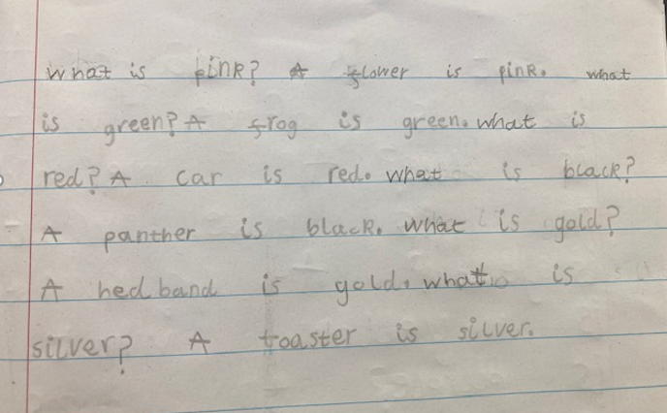
How we teach writing at Golden Valley

Slide 2
Writing is a complicated, complex process that must be taught in small steps focussing on Transcription first.

Slide 3
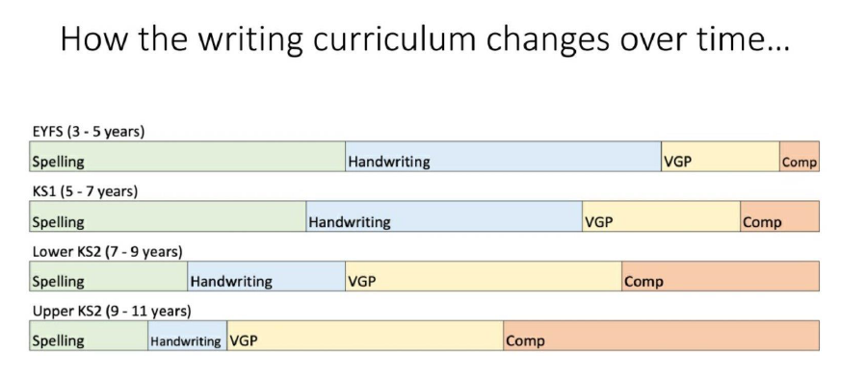
VGP- Vocabulary, Grammar, Punctuation
Comp- Composition
The research is clear that for children to be successful writers, they must master handwriting and spelling before they are asked to write down their own stories. Phonics is key as is mastering handwriting and understanding what a sentence is.

Slide 4
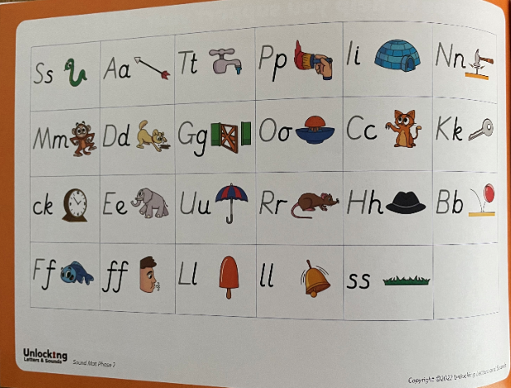
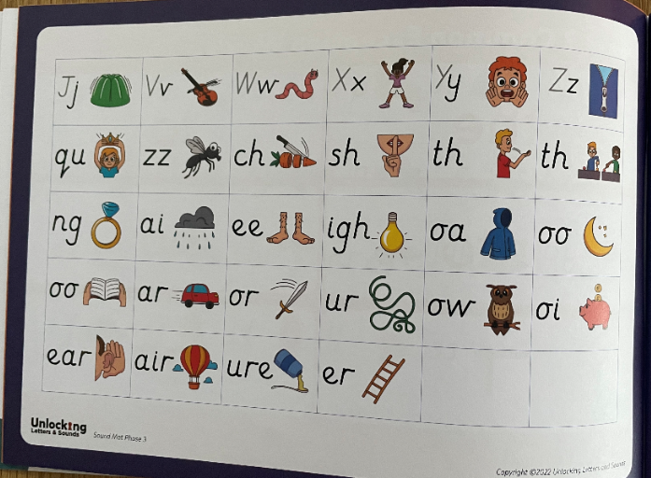
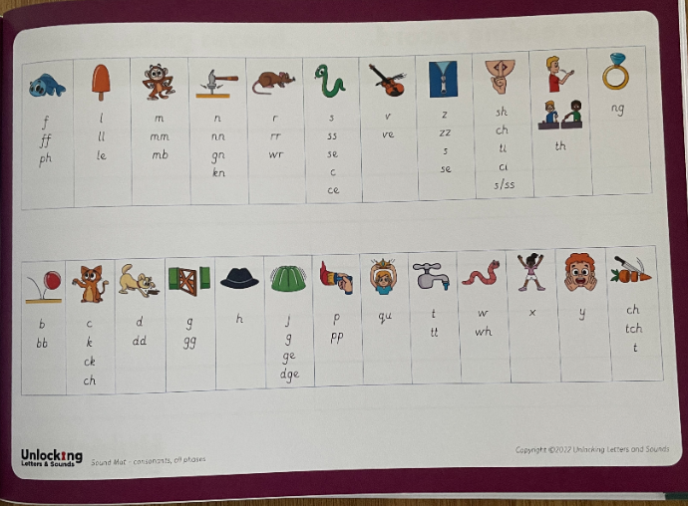
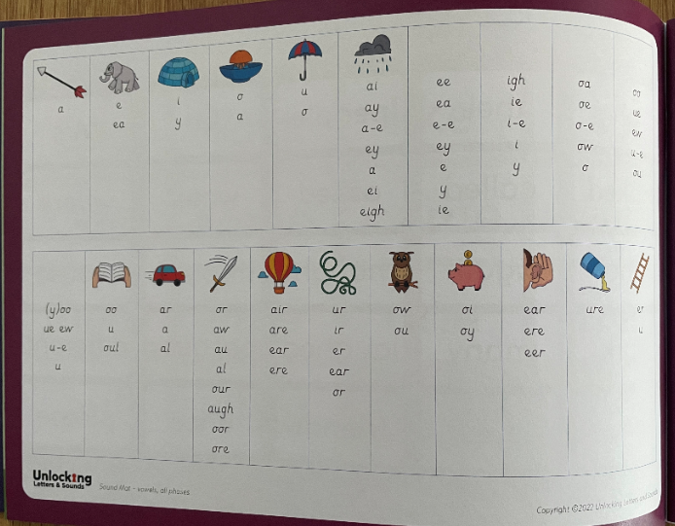
Within the new reading records, you’ll also find the ULS sound mats. Your child will be familiar with using these to support their writing in school. If you’re child is doing any writing at home, use this resource to support them.
Notes:
.

Slide 5
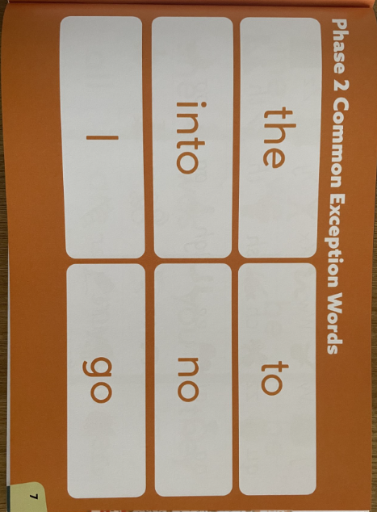
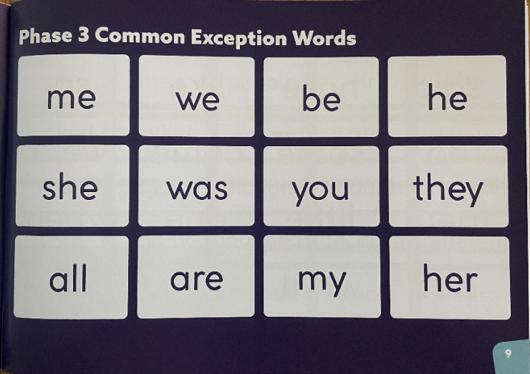
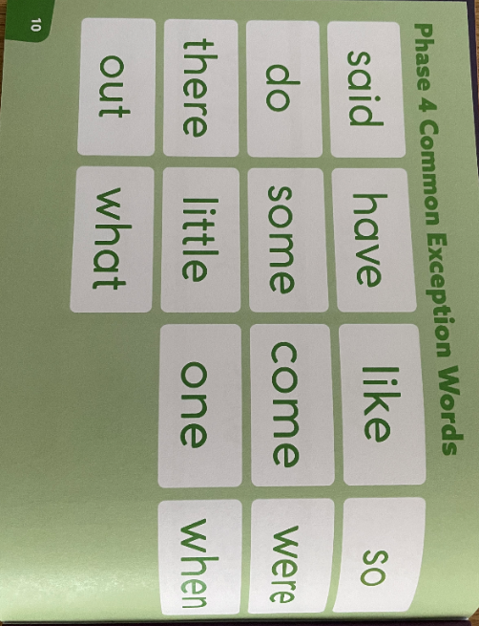
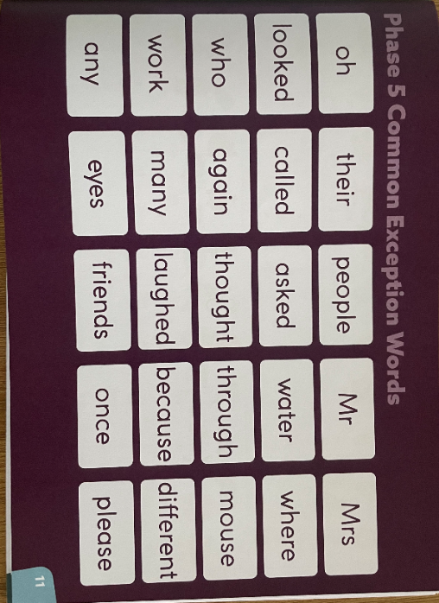
Common Exception Words
A common exception word is a word that we can’t sound out using phonics; these are common words in the English language that we must learn to read by sight. Your child will have been taught phase 2, 3 and 4 CEWs throughout Reception and there are opportunities within phonics lessons to revisit these. In Y1, pupils will learn the phase 5 CEWs. When teaching CEWs, we show the children the word and tell them what it says, we then ask them to spot the phonics clue/s and the tricky part/s.
All the classrooms have these available as word banks for children to refer to when they are writing.

Slide 6

Our units of work typically last two to three weeks and will be based on a picture book or short novel.
These are the texts that we will be using next term.
LSP are supporting schools with planned units that can be adapted for our children.

Slide 7

https://www.goldenvalleyschool.co.uk/attachments/download.asp?file=311&type=pdf
This document is on the school website and shows the learning for each year group, term by term.

Slide 8
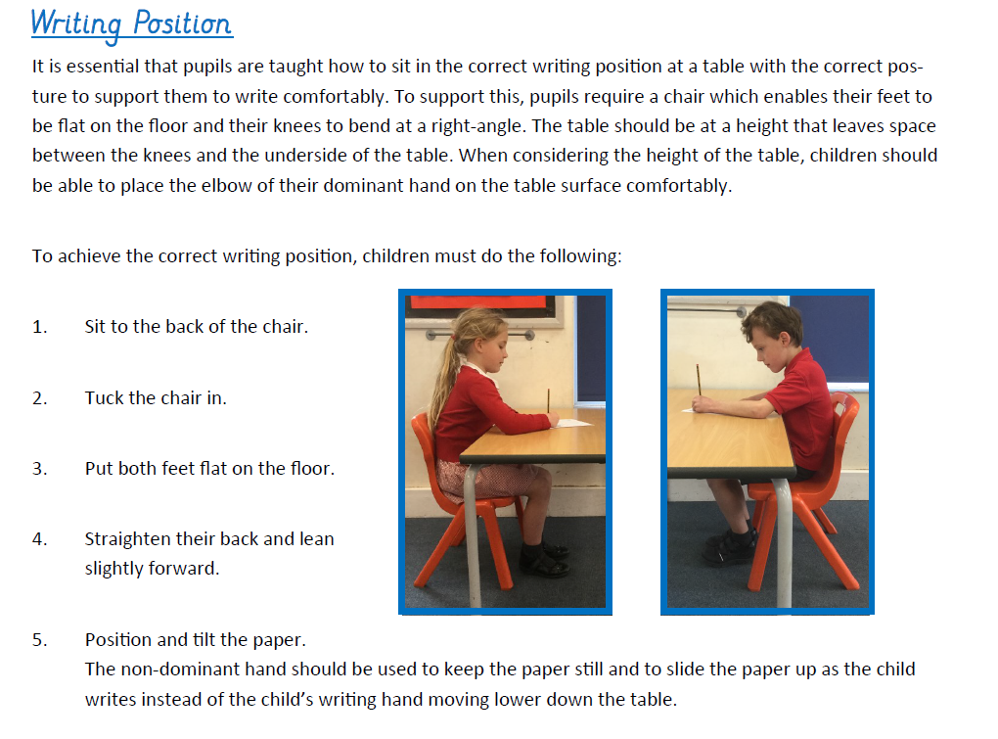
HANDWRITING
The correct writing position and pencil grip are important. Fluent writing reduces the cognitive load so the brain can focus on the other aspects of writing.

Slide 9
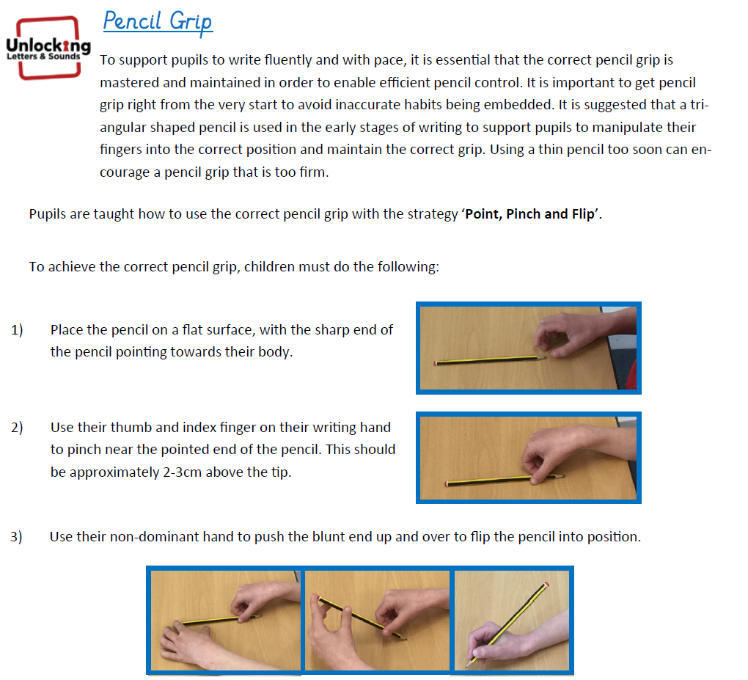

Slide 10
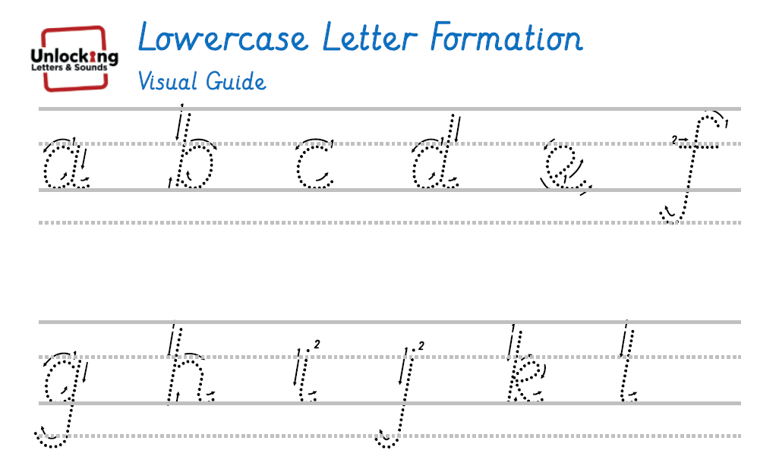
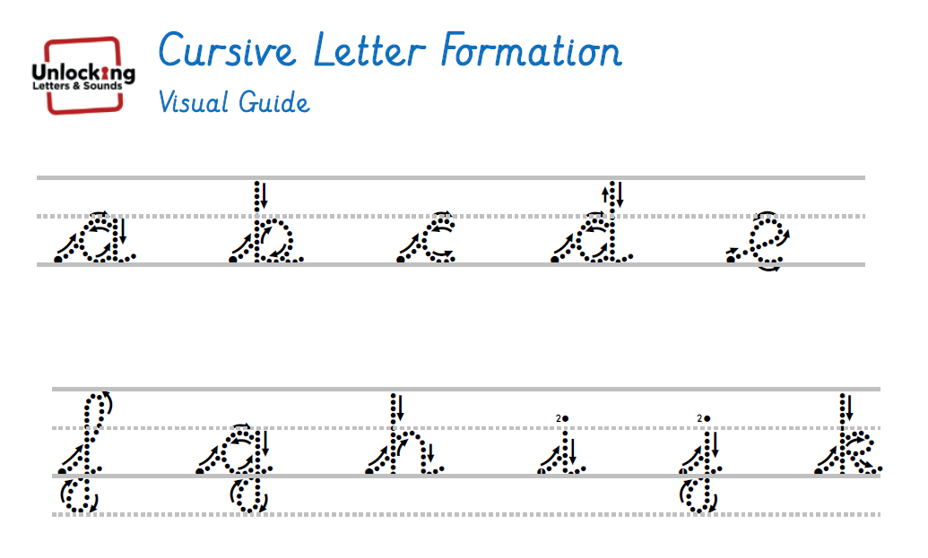
Start in Reception with printed letters.
In Y2, children are taught the lead-ins and begin to learn joined handwriting in Term 3. These resources are on our website so that you can support at home.

Slide 11
In early years and KS1
Phonics is key- initially, during writing lessons, children are only expected to write words containing the sounds that they know.
They will however, learn stories and retell them orally and have lots of stories read to them to enrich their language.
Structure of lessons
I do ( Teacher modelled)
We do (altogether )
You do (have a go at the word or sentence)
The main focus is on Transcription
Handwriting: Forming letters correctly and fluently
Spelling: Using correct spelling to make words understandable

Slide 12
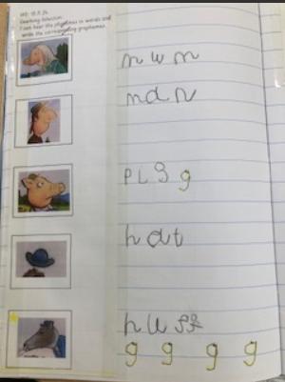
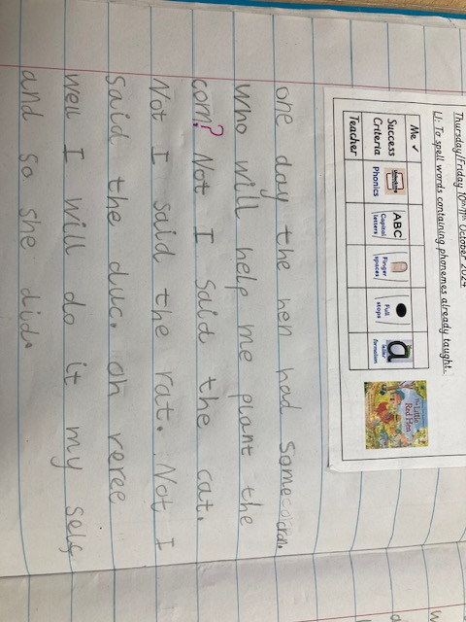
I do, we do, You do (Reception) Year 1- had a story map and puppets to learnt the story- acted it out. Children were able to use their phonics to spell the words were dictated to them.
Reception
Year 1
Year 1- had a story map and puppets to learnt the story and then acted it out. They were able to use their phonics to spell the words that were dictated to them.
I do, we do, You do (Reception) using the
Three Little Pigs story.

Slide 13
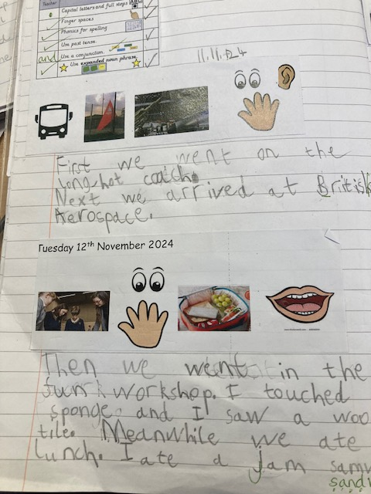
By Christmas in Y2, children will have completed the phonics programme and will begin to learn spelling patterns and rules.
Transcription is still the main focus but children are beginning to write more independently, using what they have been taught. The writing is still controlled and they are not expected to compose whole stories independently.

Slide 14
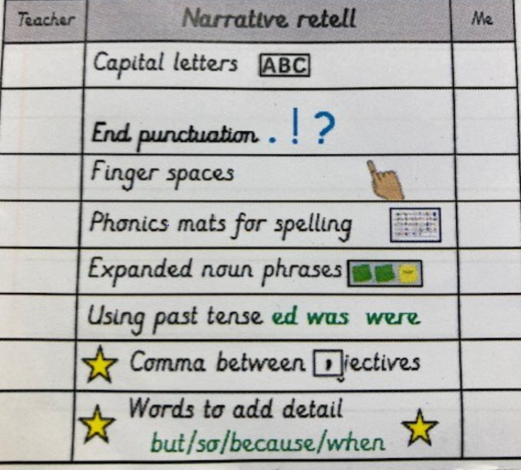
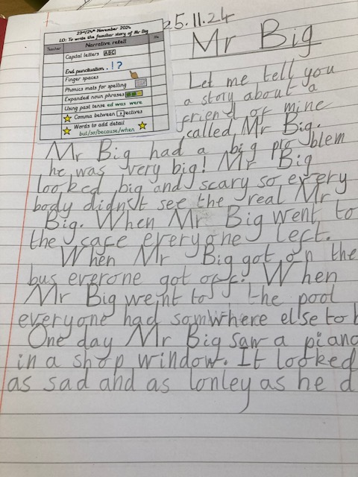
The children learnt part of the story and then used the Common Exception Word Mats and Phonics Mats to support their spelling as they wrote.

Slide 15
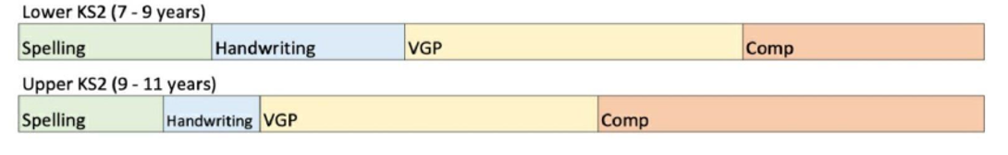
As children move through KS2, the same I do, We do, You do model is followed.
Throughout KS2, the teaching of grammar (sentence and punctuation work) increases. Children are explicitly taught elements of grammar e.g. using adverbs to start sentences and then given opportunities to firstly practise in sentences before applying what they have learnt in short writing tasks and finally in longer texts.
Gradually, the emphasis on composition increases until the end of Year 6 when the children are given more opportunities to plan and compose their own texts.
Word banks are given to support spelling and reduce cognitive load. Some children will be supported by members of staff in guided groups or the task will be adapted to offer more support.

Slide 16
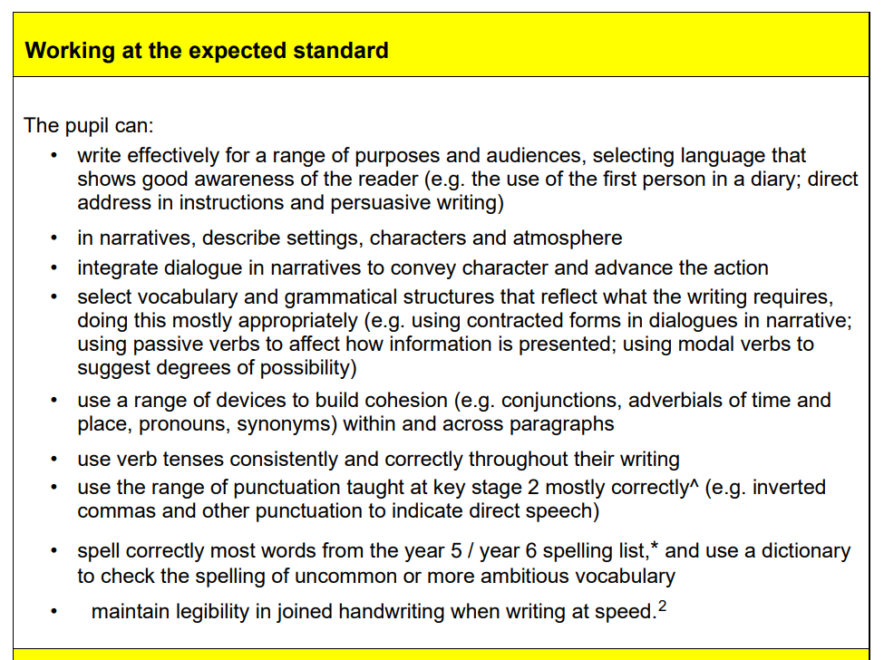
Year 6
SATs- writing is
Teacher Assessed (TA)
TAF- Teacher Assessment
Framework
Y6 children are working towards meeting the EXS standard in writing. These are the objectives that children are aiming to secure by the end of Year 6.

