Slide 1
Welcome to Year 6 Parent Information Evening

Slide 2
Who teaches your children?
The class teachers are: Falcon Class - Mr Morgan
Kestrel Class – Miss Anderson
Learning Support Assistants are: Mrs Pye and Mrs Lamb.
Please come and speak to us on the playground before and after school if there is something that we need to be made aware of. Alternatively, send us an email through the office and we can arrange a call. We need to work in partnership to ensure that 'our' children are happy in school and are able to make the most of their learning.

Slide 3
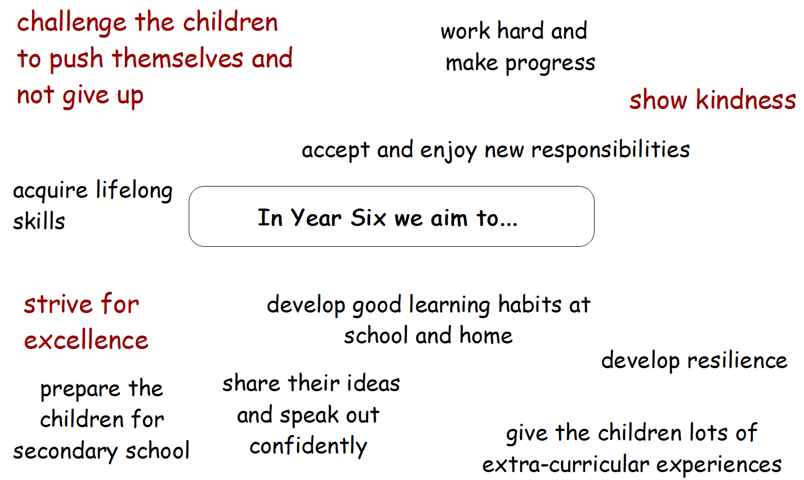

Slide 4
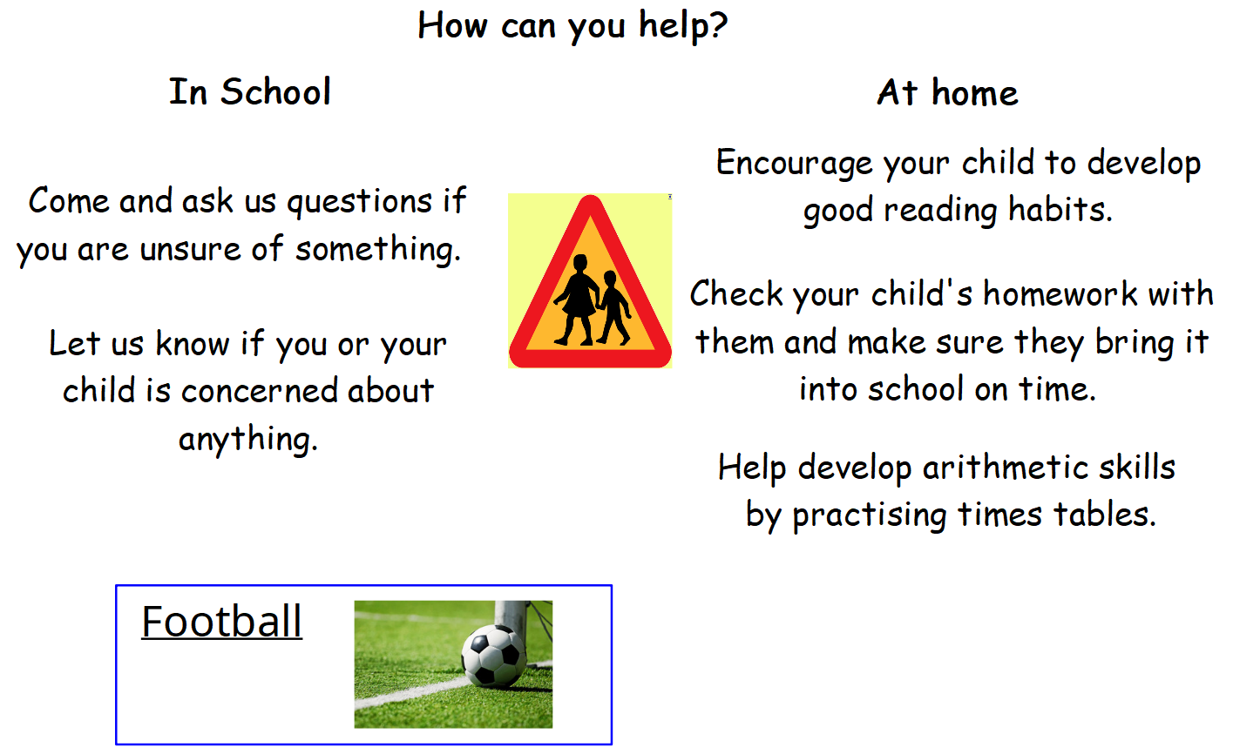

Slide 5
End of KS targets and SATs:
SATs is only one week out of Year Six learning. Year Six is not all about SATs!
- Children will be formally assessed by us in October, January and March
- SATs are planned for the wk beg: 11th May 2026
- SATs currently assess reading, spelling, punctuation and grammar and maths (reasoning and arithmetic).
- Writing is teacher assessed and moderated internally, with other schools and possibly externally by Bristol.

Slide 6
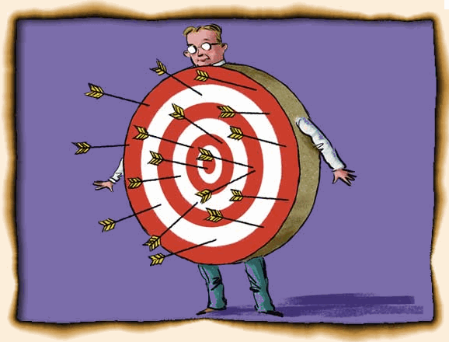
Targets:
Children are working towards End of Year Expectations for Y6.
We constantly track children's progress and run short interventions as necessary.
SATs
Children will either reach Expected Standard, not reach Expected Standard or be judged as having achieved Greater Depth within the Expected Standard.

Slide 7
How will we help your child to approach SATs confidently?
Occasional practice papers to help time management and test techniques
SATs breakfasts
We will be running different Maths Booster Clubs after school for those children who would most benefit from a boost in confidence and experience. This is usually 3:30-4:30pm. Parents will be notified in advance.
Small group intervention work and extra activities to help with tricky areas of learning.

Slide 8
Planners are needed every day!
We use them for...
- spelling lists
- homework reminders
- important dates
reading record
You can use them for...
- checking what homework has been set
- recording a comment if you have heard your child read

Slide 9
Homework:
Maths and English: given out on a Friday and due in every Wednesday
Please support your child with their homework by talking it through with them, discussing any misconceptions and quality checking! Please do not spend hours and hours on homework!
We always go through homework in class and give feedback in an appropriate way.

Slide 10

Reading, reading, reading...
It is essential that your child is reading at least 4 times each week for about 20mins each time (every night if possible).
Your children understand the expectations so we would appreciate your support with this. Reading is the key to success in every subject and will impact on the rest of their lives.

Slide 11

Health:
- fresh fruit snacks please
- water bottles
- inhalers and allergies
- periods
- personal hygiene
- being excused from PE

Slide 12
Personal belongings and safety:
- mobile phones - make sure we have a copy of a signed mobile phone agreement
- uniform and school bags
-coat/waterproof jacket
- P.E kit (joggers/sweatshirt, hat etc.)
- everything named please!
Online Safety/Gaming
Please monitor your children's use of online games, streamed viewing and social media. Problems with inappropriate language and content being discussed in school.
We have lots of issues with children's use of WhatsApp in the past.

Slide 13
Y6 Trips and Activities
Fieldwork trip – Scotch Horn
STEAM trip – History link
Life Skills
Bowling
Camp- 8th June – 12th June
Y6 Production in July
There will also be a Leavers' Assembly.

Slide 14
Transition to Year 7:
please apply online at North Somerset Council, Education (or request a paper copy);
check the closing date (you should have received your letter);
for visits during school time, thank you for requesting permission from Mr Riordan.

Slide 15
Questions?

