Slide 1

Welcome to year 2!

Slide 2
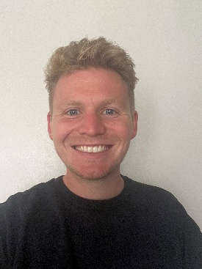
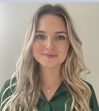
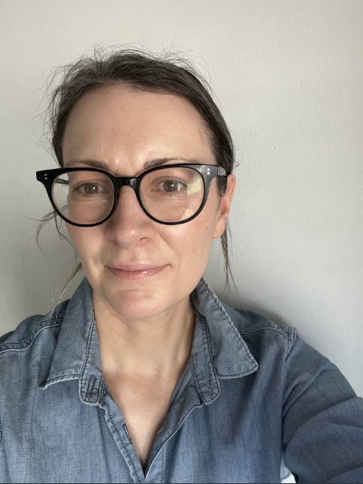
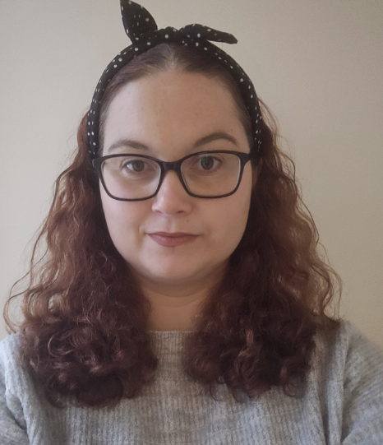
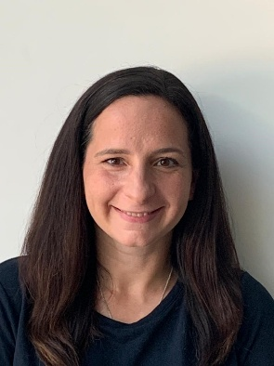
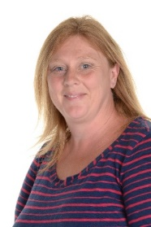
Meet the team
The class teachers are Mr Doul in Swallow class and Miss Weston in Blackbird class. Miss Savidge is the Learning partner for Swallow class primarily and Ms Lacey is the Learning Partner supporting Blackbirds. Mrs Chandler and Ms Pye will cover year 2 classes when teachers are having time for planning, preparation and assessment (PPA). This is alternate Monday and Friday afternoons.

Slide 3

In Year 2, in line with the rest of the school, we do things ‘The Golden Valley Way’
Our expectations are consistent across the school, and are derived from the principle of being Ready, Respectful and Safe.
‘Wonderful walking’
‘Wonderful listening’
Sharing Kindness, Challenging Ourselves and Others, and Achieving Excellence.

Slide 4
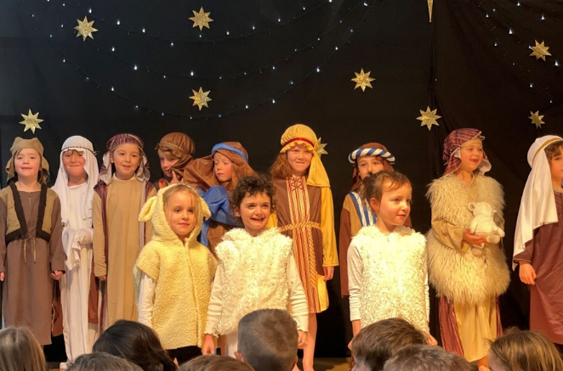
The year ahead
We are really excited for the year ahead!
Some of the units of learning that we will be covering will be seafaring around Bristol and Isambard Kingdom Brunel in History, sewing Christmas decorations and making homes for animals in Design & Technology, learning how to keep ourselves healthy in PSHE and habitats and plants in science.
Year 2 Nativity!
We have some exciting trips and visitors planned to really bring the curriculum even more to life!

Slide 5
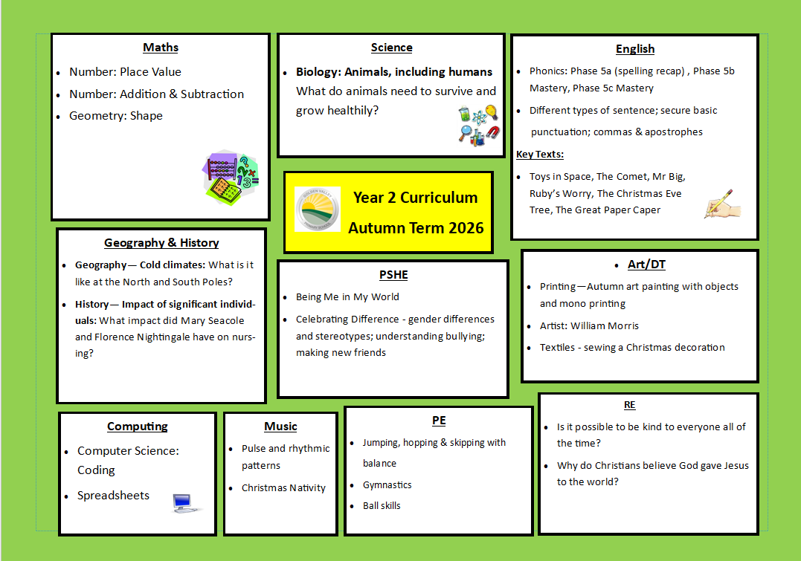
Notes:
Learning this term (until Xmas)- on GV website. New term’s information will be uploaded for your information – please ask your child about their learning!

Slide 6
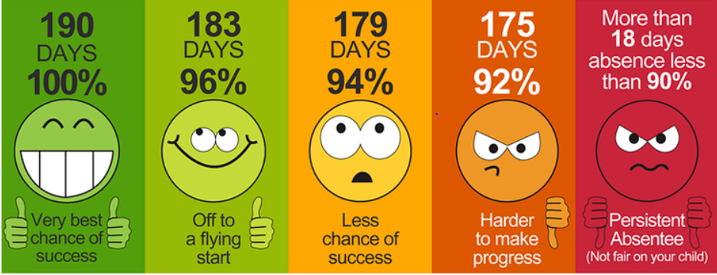
attendance
Good attendance (over 95%) is a minimum expectation in all schools and it is essential for all children to meet this expectation if they are to maximise their progress with us.
Arriving late is really unsettling for children and disruptive to the rest of the class. Please help us to have a great start to the day by arriving by 8:50). If your child arrives at school after the classroom doors are shut, you need to sign them in at the office.

Slide 7

Books going home
Children will receive two books a week. One will be a fully decodable independent book that has been selected based on our teacher assessments within school. The other book will be a library book.
We do not expect the children to be able to read these independently, but to share with you and promote a love of reading.
Please write in their reading records when a book has been read so that we can celebrate that in school and reward with house points.

Slide 8
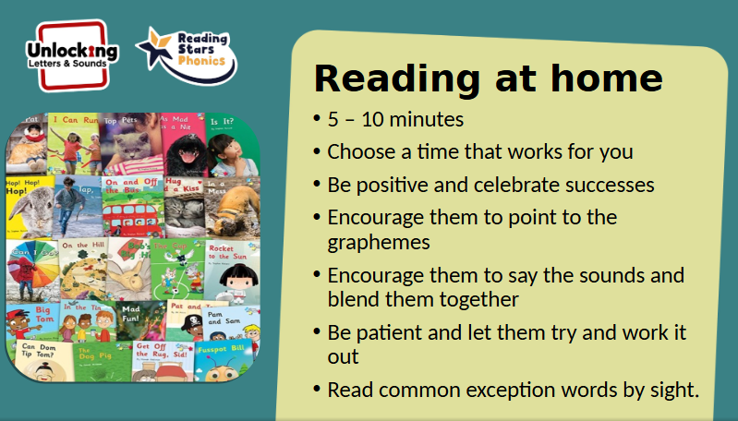

Slide 9

Notes:
Year Two builds on the reading focus of Year 1. Our focus is still on phonics and being able to read fluently. If they can’t read then they are going to miss out across the curriculum. We need your support with this at home. Please aim to read with your children for at least 10 minutes. This should be completed regularly throughout the week. We are looking for at least 4 entries a week in the reading record.
We are currently doing 2x whole class phonics lessons a day using the ULS scheme, including a revisit from the end of year 1’s lessons to embed learning. Expect to finish the Phonics programme for whole class learning after Xmas, at which point we will move onto guided reading and reading fluency in preparation for year 3 and KS2.
If your children reads for 10 minutes a day, 5 days a week, then they will have read for 60 hours in a whole year! Research tells us that children who read for 10 minutes a day can make up to a year/s additional progress.
Significant evidence that reading is linked to important developmental factors in children, improving their cognition, mental health, and brain structure, which are cornerstones for future learning and well-being.

Slide 10

Some reminders
PE Days: Tuesday and Thursday (Week A) Thursday and Friday (Week B)
Please ensure that all uniform is named and labelled. This allows us to return items to the owners quickly.
Children will need to come into school every day with a named water bottle with fresh water in it.
We are happy for children to bring in an out of school achievement (e.g. swimming badge, football trophy or summer reading challenge certificate) for Show & Tell or if they have something relevant to what we are learning about. However, please can we ensure that no other objects from home are being brought into school.
Reading records and books should also be in school every day.
End of day, please do step forward when you see us with your child to help with the dismissal. It’s really hard to try and pick a parent out amongst a sea of faces!
Any issues in school, please remember we are your first port of call.
Notes:
Show & Tell can also be any learning that happens at home e.g. stories, maths, drawings of something related to the classroom.

Slide 11

Important dates for your diary
Parents Evening - 20th/22nd October 2026
Geography Nowhere Woods leaf printing Nailsea - October 2026
Nativity – Wednesday 9th / Thursday 10th 2026
Share a Tray – 7th December

Slide 12
Pupil premium
If you think you may be eligible for Pupil premium support, please do contact the school office who will be able to help you.
You can apply for free school meals and Pupil Premium if you get any of these benefits:
Universal Credit if your household income is less than £7,400 a year or £616.67 a month after tax
Income Support
Income-based Jobseeker's Allowance
Income-related Employment and Support Allowance
the guaranteed element of State Pension Credit
Child Tax Credit (as long as you're not also entitled to Working Tax Credit and have an annual gross income of no more than £16,190)
Working Tax Credit run-on (paid for four weeks after you stop qualifying for Working Tax Credit)
support under Part 6 of the Immigration and Asylum Act 1999
The money will be used to support your child all the way through primary school once applied for.

Slide 13
Any questions?

