Slide 1


Welcome to Year 4
Parent information meeting –Thursday 17th September 2026

Slide 2
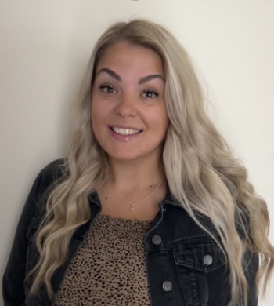
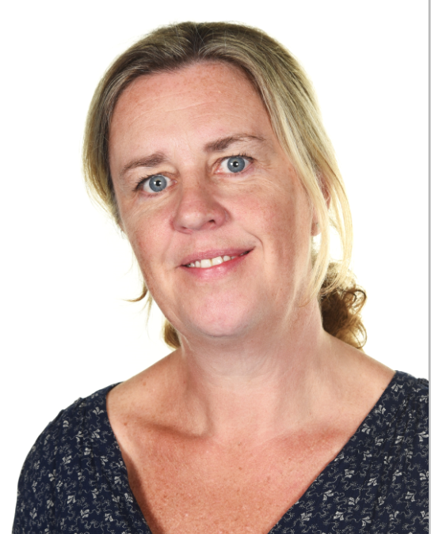
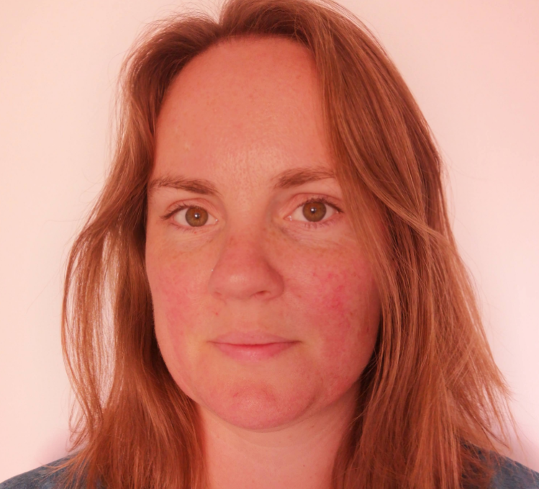
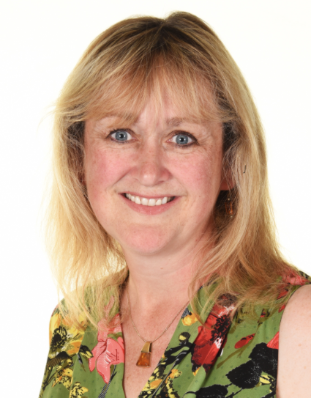
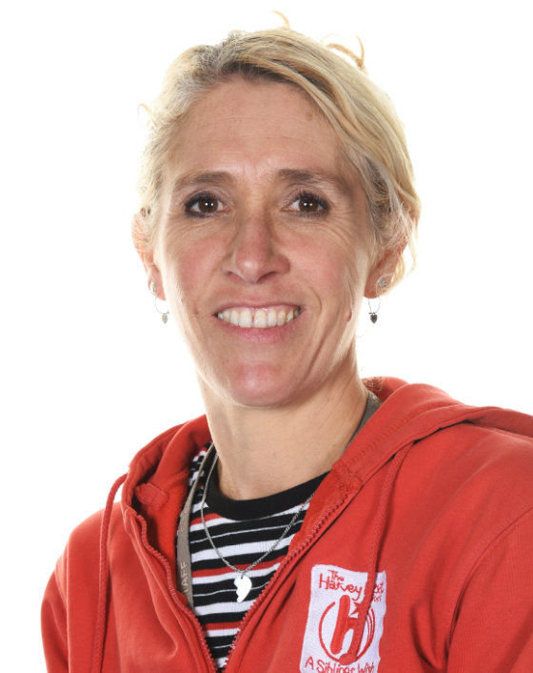
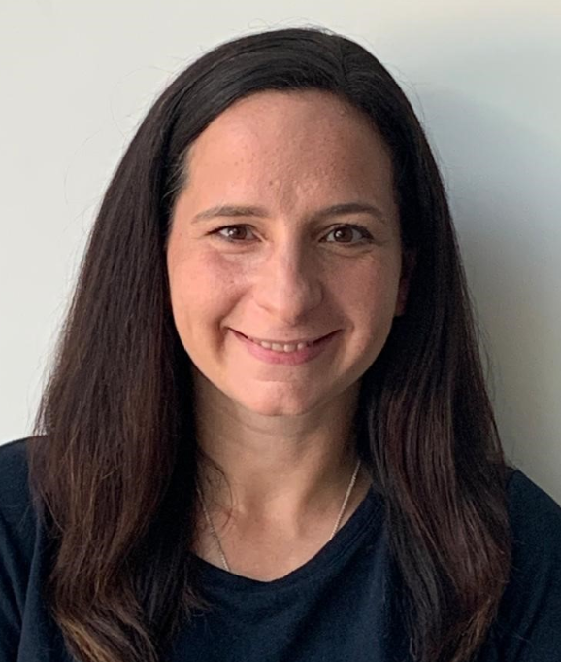
Adults who work with your child
Swift Class | Wagtail Class
Class Teacher Ms Macadam (Mon-Wed) Miss Somerville (Th & Fri) | Class Teacher Mrs Hobbs
Learning Partners: Mrs Weaver Mrs Nichols
Mrs Pye/SHINE sports coaches covers PPA time (Week A – Tuesday pm/Week B – Thursday pm)

Slide 3
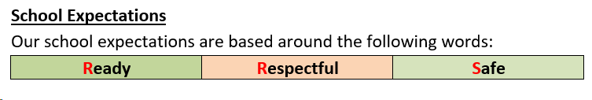
School expectations

Slide 4
Sharing Kindness
Challenging ourselves and others
Achieving excellence

Slide 5
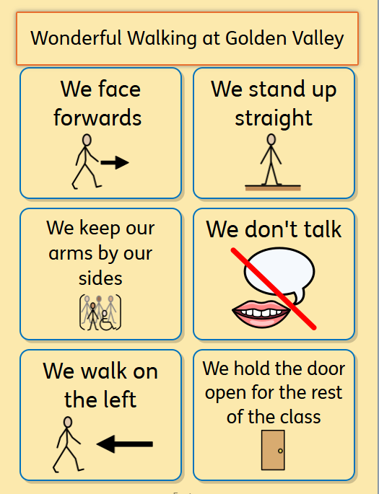
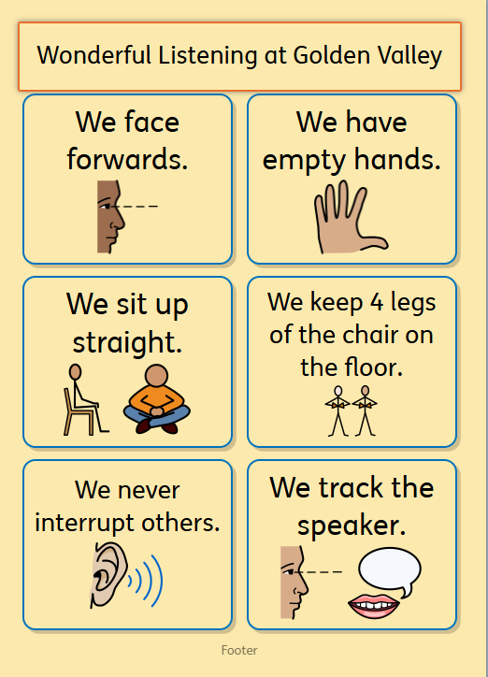

Slide 6
In Year 4, we aim to…
To grow in confidence and become more independent learners.
To develop good learning habits at school and home.
To get along and understand others; be responsible for the choices we make.
To develop our oracy skills.
To challenge ourselves to push ourselves and not give up: develop resilience.
To work hard and make progress.
To try new things.
To enjoy school and have fun!

Slide 7
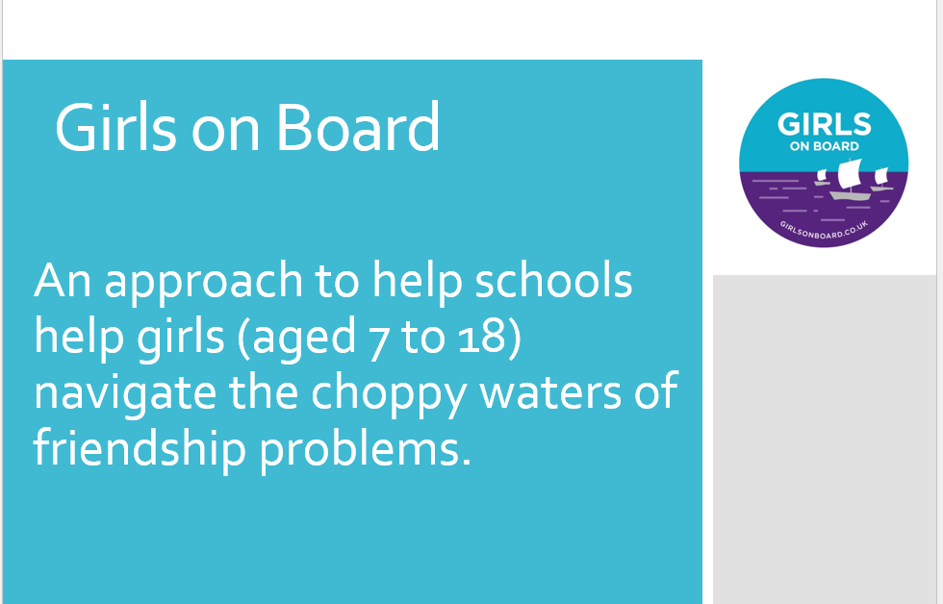
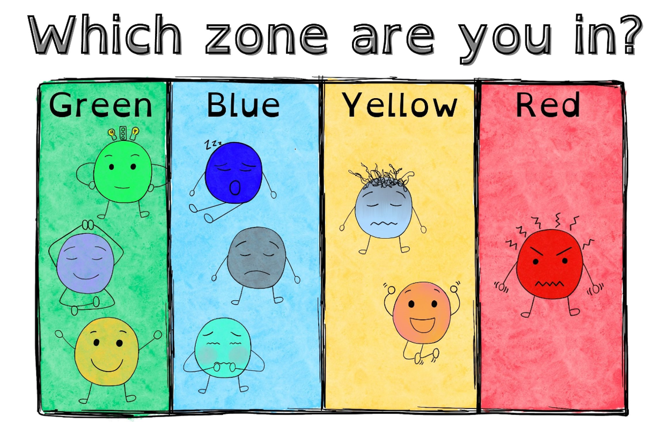
Well- being

Slide 8
Health and belongings
Fresh fruit for snacks please
Water bottles
Reading book (home or school)
Named belongings
Children do not need to bring their own stationery
Notes:
Children may not share snacks
Water only
Healthy snacks – keep separate from packed lunch if possible
No nuts – including Nutella (we have children with severe allergies in our year group)

Slide 9
Trips and Workshops
Wessex Water workshop 28th September
Chedworth Roman Villa 3rd November
In Terms 4 and 5 we will be taking children for their swimming lessons.

Slide 10
Homework
English homework will be set weekly, on a Friday. This needs to be handed in on Wednesdays.
Please support your child to do their homework. If they are struggling with it, or are unable to complete it for some reason, please let us know.
Children should also be practising their times tables at home.

Slide 11

Reading records (‘Fish’ Books!)
Reading Records are needed in school every day and we encourage the children to look after them.
Children are encouraged to record important dates in them at the start of the week including PE days.
We will record if your child has read individually with an adult in school.
Children have a reading fluency session with their teacher three times a week as well as two extended read sessions.
They also have a one hour reading comprehension lesson a week. These won’t be recorded in your child’s ‘Fish’ Book.

Slide 12
Multiplication Tables Check (MTC)
All Year 4 pupils complete a Multiplication Tables Check in June.
This is a national test and children are expected to know all their tables up to 12 x 12.
We teach a daily Mastering Number lesson which helps the children develop their conceptual understanding as well as practising their times tables.
Children should use TT Rockstars to practise these in a fun and engaging way, and there are lots of times tables songs and raps on YouTube.
Tablets are the preferred tool to practise because we will complete the MTC on an iPad.

Slide 13
Assessing your child’s progress
Children are formally assessed against a series of statements in Maths, reading and writing.
Progress in other subjects is monitored and assessed against National Curriculum objectives.
Throughout the year, the children’s progress is assessed by their teacher and next steps are carefully planned.
In Autumn 2, Spring 2 and Summer 2, the children complete more formalised assessments (marked by us) which helps inform the teacher assessment.
At the end of the year, children are assessed in reading, writing and Maths using the following statements: working towards the expected standard (emerging); working at the expected standard (expected); working above the expected standard (Greater Depth).

Slide 14
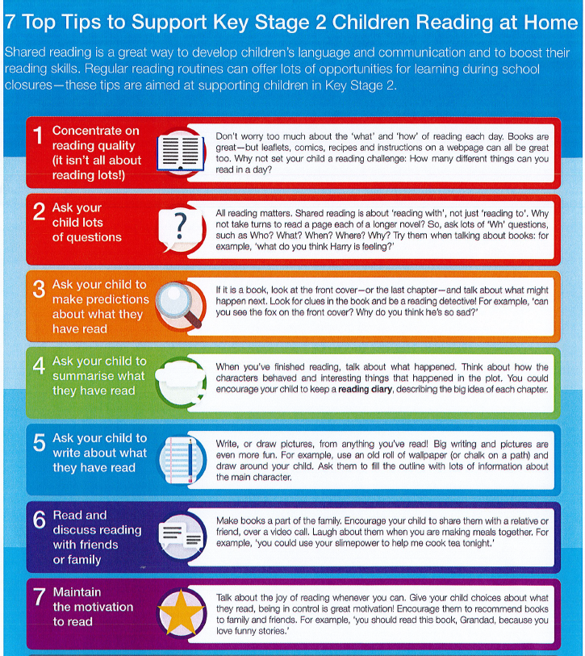
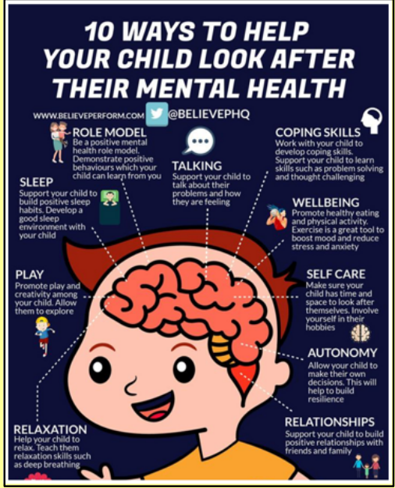
How you can support your child at home

Slide 15
Communication
For medical appointments, attendance etc. please contact the School Office.
Please contact your child’s teacher in the first instance for anything else – they should be your first port of call.
We can be contacted face-to-face at drop off/pick up, email via the Office or leave a message and we can call you back.
Please be aware it may take up to two working days for us to respond.

Slide 16
FAQs
Will my child be allowed to go to the toilet during lesson time?
Yes. Children are allowed to use the toilet when they need to, but do need to ask so that we know where they are. We allow one child at a time to go to the toilet. Sometimes we might ask a child to wait a couple of minutes, especially if we are in the middle of a teaching input, or if it is almost playtime or lunchtime. Children can either ask the teacher or use their hands to show a T if they need to go.
Will my child be allowed free access to their water bottle?
Water bottles are kept in boxes in the classrooms and are accessible throughout the day. At lunchtime the boxes are placed outside so that the children can get a drink without needing to come inside. Children are not allowed to get up to get a drink while we are directly teaching, but are free to have a drink once they are working independently.

