Slide 1

Welcome to year 1!

Slide 2
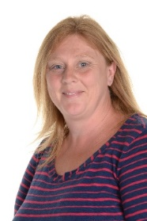
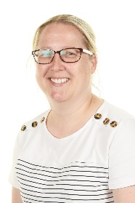
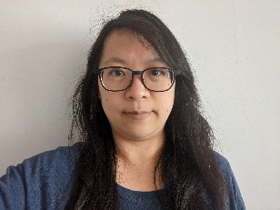
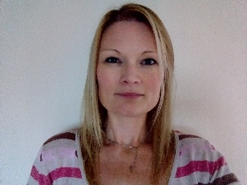
Meet the team
The class teachers are Mrs Devanny in Goldfinch Class and Miss Olden in Kingfisher Class. Mrs. Chandler, Ms Lim and Mrs Sherreard are our learning partners. Mrs Chandler and Mrs Merceica will work with both classes when teachers are having time for planning, preparation and assessment (PPA). This is on a Wednesday afternoon.
Notes:
Jess

Slide 3
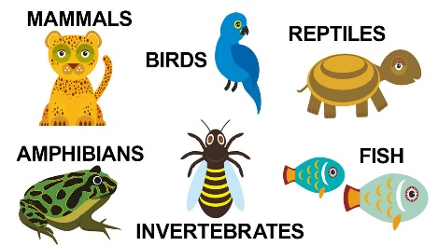
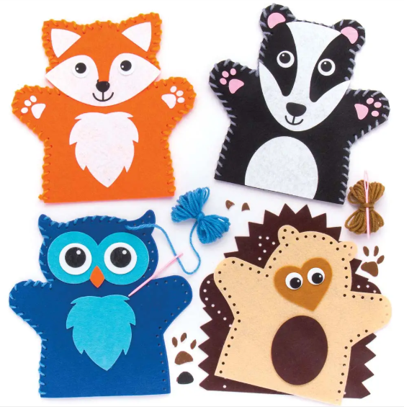

The year ahead
We are really excited for the year ahead!
Some of the units of learning that we will be covering will be the Great Fire of London in History, sewing puppets in Design & Technology, learning how to keep ourselves healthy in PSHE and exploring different animal groups in science.
We have some exciting trips and visitors planned to really bring the curriculum even more to life!
Notes:
Ella

Slide 4
Some reminders
PE Days: Monday and Thursday.
Please ensure that all uniform is named and labelled. This allows us to return items to the owners quickly. Please add loops to jumper tags to help children hang these up!
Children will need to come into school every day with a named water bottle with fresh water in it.
We are happy for children to bring in an out of school achievement (e.g. swimming badge, football trophy or summer reading challenge certificate) for Show & Tell or if they have something relevant to what we are learning about. However, please can we ensure that no other objects from home are being brought into school.
At the start of the day, please ensure your child is lined up in their correct class line for 8:40am. This helps ease with transition and helps to prepare them for the day ahead. At the end of the day, please do step forward/ wave when you see us with your child to help with the dismissal. It’s really hard to try and pick a parent out amongst a sea of faces!
Any issues in school, please remember we are your first port of call.
Notes:
Ella

Slide 5
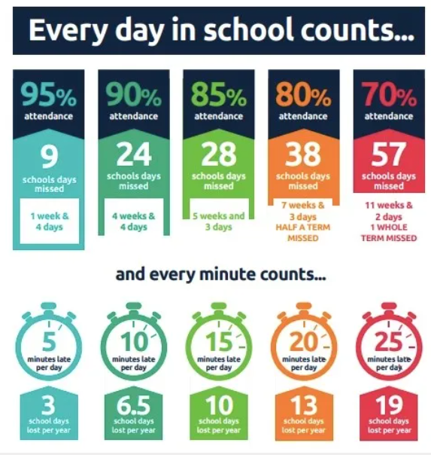
attendance
Good attendance (over 95%) is a minimum expectation in all schools and it is essential for all children to meet this expectation if they are to maximise their progress with us.
Arriving late is really unsettling for children and disruptive to the rest of the class.
Please help us to have a great start to the day by arriving by 8:40 am.
Notes:
Ella

Slide 6
Pupil premium
If you think you may be eligible for Pupil premium support, please do contact the school office who will be able to help you.
You can apply for free school meals and Pupil Premium if you get any of these benefits:
Universal Credit if your household income is less than £7,400 a year or £616.67 a month after tax
Income Support
Income-based Jobseeker's Allowance
Income-related Employment and Support Allowance
the guaranteed element of State Pension Credit
Child Tax Credit (as long as you're not also entitled to Working Tax Credit and have an annual gross income of no more than £16,190)
Working Tax Credit run-on (paid for four weeks after you stop qualifying for Working Tax Credit)
support under Part 6 of the Immigration and Asylum Act 1999
The money will be used to support your child all the way through primary school once applied for.
Notes:
Jess

Slide 7
We love reading!
Reading for pleasure
Finding out information
Reading the world around them
Understanding forms and official documents
Accessing learning
Notes:
Ella
We read for many different purposes…
In EYFS and KS1, pupils are very much focused on learning to read. As they move higher up the school and into secondary education and beyond they will be reading to learn. So it is vitally important that we support our youngest pupils to quickly learn to read. We want every child to love reading and to do this we must make sure that it is a pleasurable experience and that they can read with accuracy and fluency so they can access as many opportunities as possible.
Over the past 50 years schools have taught children to read using lots of different approaches. But, thanks to research we know that systematic synthetic phonics is the best way to teach children to read. We know this might be different to how you were taught to read so we hope this session supports your understanding of what phonics is, how phonics is taught at GV and how you can best support your child with reading at home.
As you know, GV have adopted the Department for Education validated scheme, Unlocking Letters and Sounds. All children in the school will use Unlocking Letters and Sounds to teach their phonics and early reading. All staff have had training with this scheme so they are experts at using it.

Slide 8
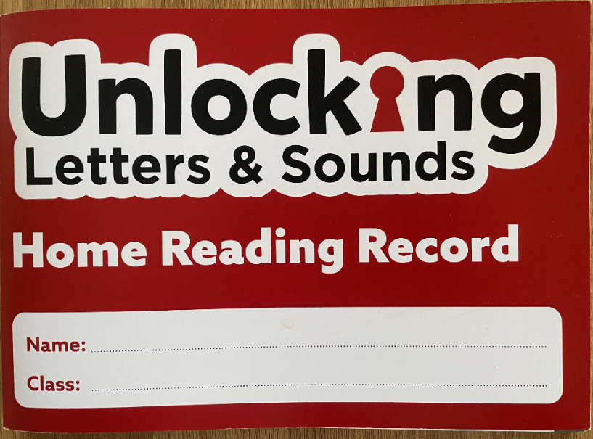
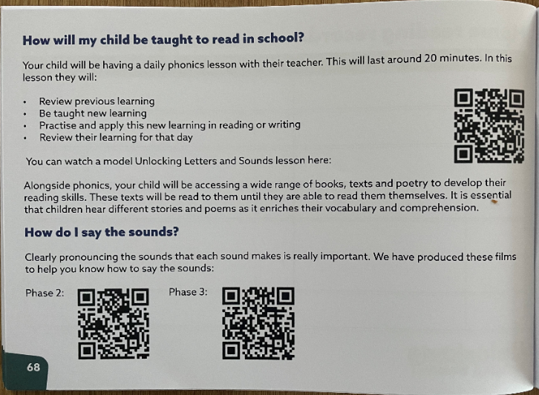
Notes:
Ella
We have purchased some brand new Unlocking Letters and Sounds Home Reading Records as these contain specific guidance about the ULS programme & useful resource links so that you know how to best support at home. On page 68 of the reading record, you’ll find a QR code which will take you to a video of a phonics lesson in action. Here, you’ll be able to see what a phonics lesson looks like. Your children are taught phonics daily until part-way through Y2. By watching the lesson video, you’ll be able to see the strategies used to support decoding and reading, and encoding and spelling everyday. There are also QR codes which will link you to videos of the phase 2 and phase 3 sounds being pronounced whilst the corresponding actions are acted out. On page 70, you’ll find a glossary with the key phonics vocabulary and their definitions.

Slide 9
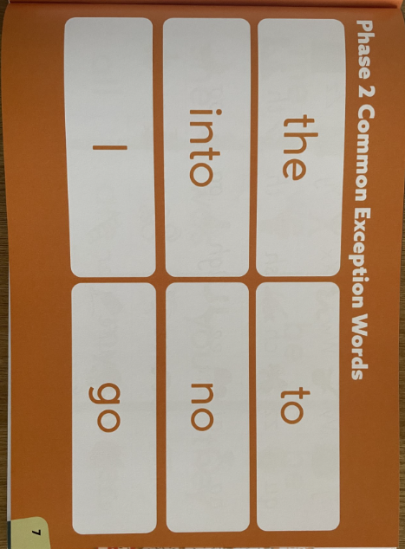
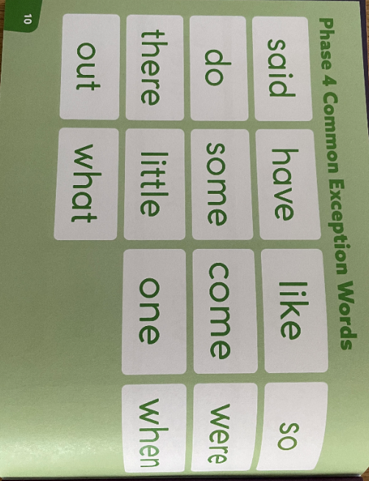
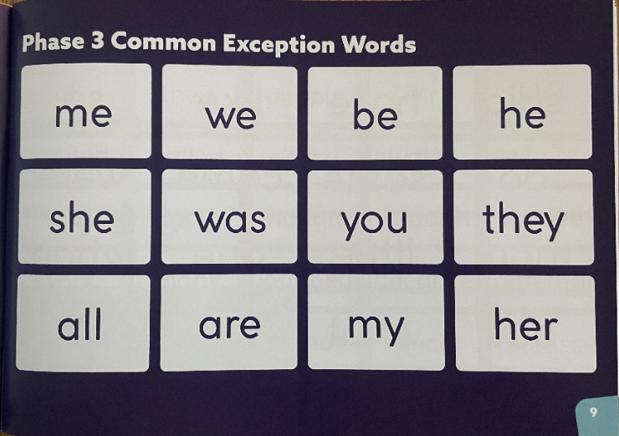
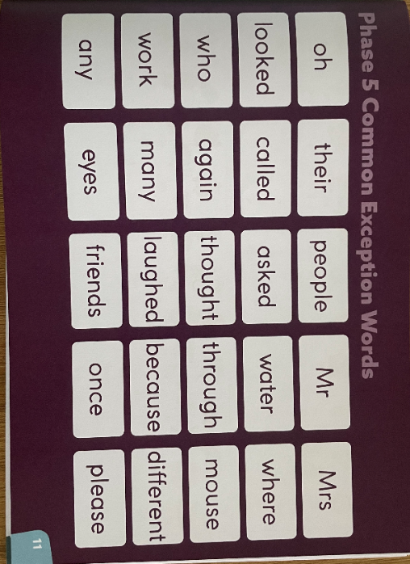
Common Exception Words
Notes:
Ella
A common exception word is a word which we can’t sound out using phonics, these are common words in the English language that we must learn to read by sight. Your child will have been taught phase 2, 3 and 4 CEWs throughout Reception and there are opportunities within phonics lessons to revisit these. In Y1, pupils will learn the phase 5 CEWs. When teaching CEWs, we show the children the word and tell them what it says, we then ask them to spot the phonics clue/s and the tricky part/s. So that you know which CEWs are gaps for your child, teachers will be ticking or highlighting CEWs that your child is secure in in their new reading record. You’ll then know that the gaps are the CEWs not highlighted/ticked.

Slide 10

Reading at home
5 – 10 minutes
Choose a time that works for you
Be positive and celebrate successes
Encourage them to point to the graphemes
Encourage them to say the sounds and blend them together
Be patient and let them try and work it out
Read common exception words by sight.
Notes:
Jess
Reading at home is essential as it gives children the opportunity to practice their decoding and blending skills.
We know everyone is busy and children often don’t want to read out of schools. Our top tips are:
5 – 10 minutes every day is often more effective than longer times
Find a time that works for you. Reading at bed time sounds lovely but with a tired child it can often be tricky!
Celebrate what your child can do and
Encourage your child to point at the graphemes as they read – this helps them to track the words and know their place
Encourage them to say all the sounds in the words and then blend them together – you can show them how to do this.
Be patient and give them time to work it out before stepping in before stepping in If they can’t read a word model how to do it and then ask them to do it.
Let them read common exception words by sight.
One of the most important ways to increase children’s accuracy, fluency and understanding of the book they are reading is to re-read the same books several times. This is why your child will be allocated one matched text per week. On page 3 in your child’s new reading record, you’ll find a QR code which links you to a video modelling what multiple reads might look like. The film explains the value of re- reading the same book: https://www.youtube.com/watch?v=Hhu3xeNq3Kg&t=200s – class teachers will be checking reading records on your child’s guided reading day and will be awarding a house point if 3 or more reads are noted.
Whilst learning to decode and reading fully decodable books to develop accuracy, automaticity and fluency is important, there is so much more to reading! We know that decodable books are not the most exciting to read and alone, won’t give our early readers all the skills they need to develop a love of reading.
It is therefore important that you continue to read to your child and share a wide range of books with them – these should be books that children cannot decode themselves. Reading books to children is a precious and lovely thing to do – we are sure you and your child already have favourite books that you share together! By modelling reading and show how much you love reading you will be setting a fantastic example to your child.
When you read to your child you will want to:
Model how to read a book
Ask questions about what has happened to support your child’s comprehension or understanding of the text
Ask questions about characters’ feelings
Discuss the meaning of words and vocabulary
Ask children to predict what they think will happen next
Make connections with things your child has experienced or other books or films they have seen – this informal book chat is vital for fostering children’s intrinsic motivation to read.
Most importantly – show that you love reading! By modelling this you will support your child to develop their love of reading.

Slide 11
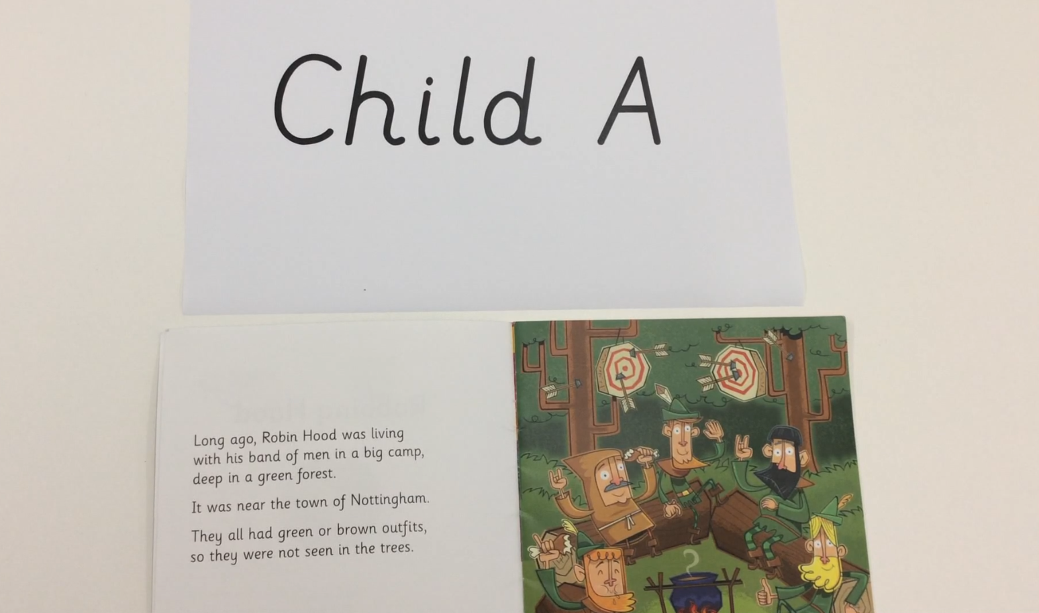
Fluent reading
Notes:
Jess
We are aiming for your children to be reading like the example of this fluent reader. This child is using intonation and expression and a child can only learn this through reading and practising the same book which is why we ask for repeated reading of their books or through hearing it when we read stories to them. So please do go to town when you are reading their bedtime stories or the library books we are sending home.

Slide 12
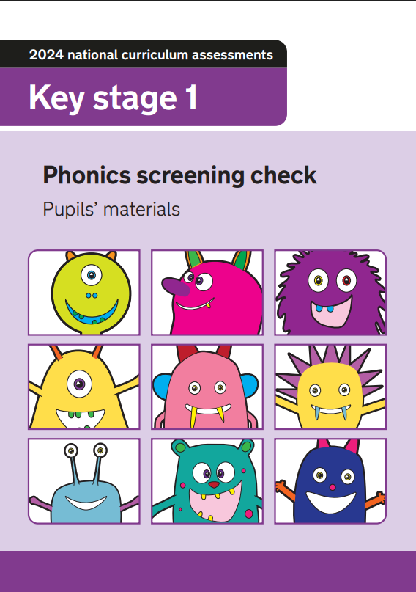
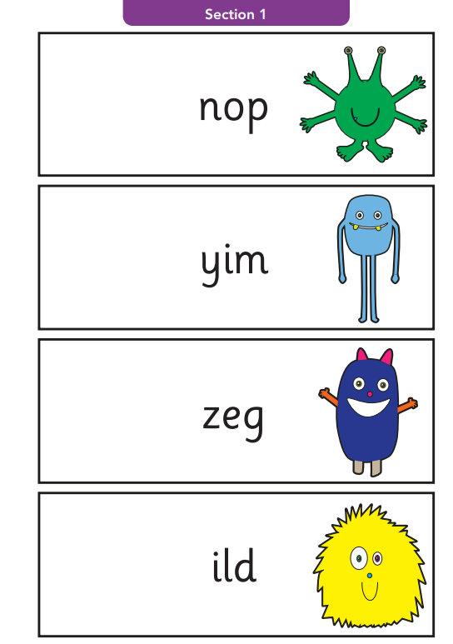
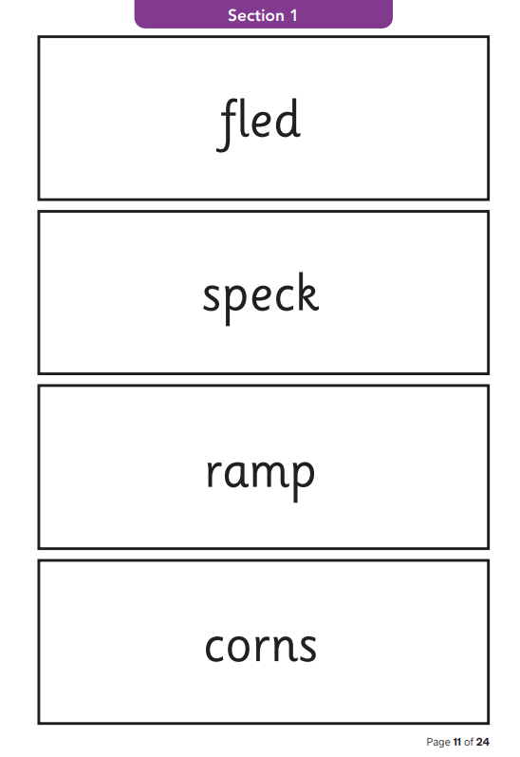
The Year 1 Phonics Screening Check
Notes:
Jess
The phonics screening check is a quick and easy check of your child’s phonics knowledge. It helps the school confirm whether your child has made the expected progress.
The national phonics screening check was introduced in 2012 to all Year 1 pupils in the country. It is a short, statutory assessment to ensure that children are making sufficient progress in the phonics skills to read words and are on track to become fluent readers who can enjoy reading for pleasure and for learning. The check will take place during the week beginning the 9th June. Please no holidays during this week or if you know that your child is going to be off, please do let us know so that we can plan for this.

Slide 13
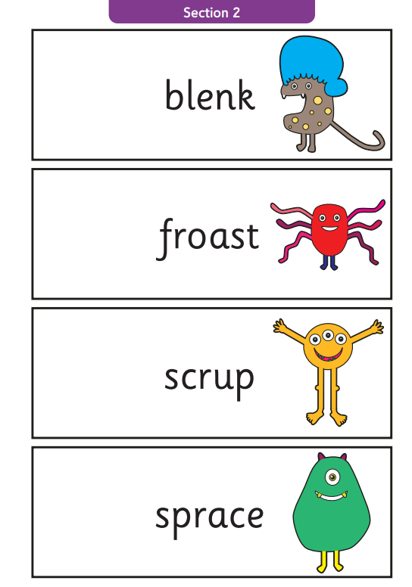
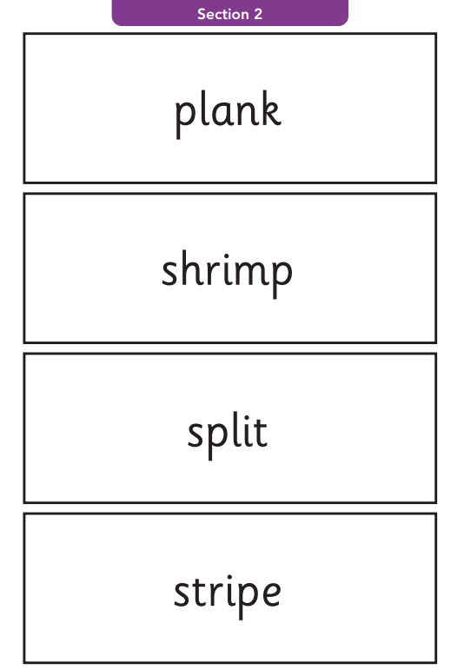
How does the check work?
Notes:
Jess
Your child will sit with a familiar school adult and is asked to read 40 words out loud. If your child is struggling, the teacher will stop. The check is designed not to be stressful.
The check consists of a list of 40 words, half of these are real words and half are nonsense words. The nonsense words will be shown to your child with a picture of an alien. Your child will have had a practise check during the year so they know what to expect.

Slide 14
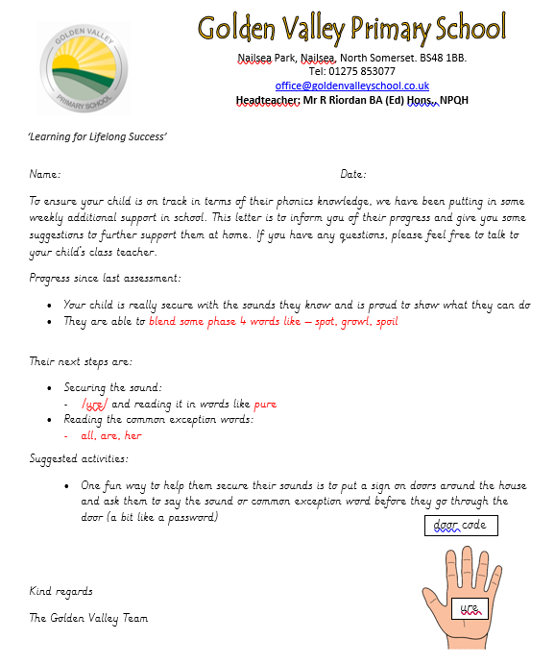
Further communication
Notes:
Jess
All children are different and, at different points in their learning, will find things more difficult or challenging. Staff at our school have all had training to identify what children are finding difficult and to help them overcome this. We know it is very tempting to compare your child to others – especially with reading and what books they are on etc but we would suggest you speak to teachers if you have any concerns. If we have any concerns we will discuss them with you.
Teachers and TAs will assess your child regularly to check their learning. We quickly identify any child who might be at risk of falling behind and will support them with extra phonics- usually by giving them ‘interventions’ to support the specific skill they are struggling with – some children may struggle to identify the GPC, others might not be able to blend yet.
If a child has SEND we may need to make adaptions to their phonics e.g. additional time to practice, more visuals. Again we will discuss these with you but research has shown that phonics is the most effective way of teaching children with SEND to read.
If your child is receiving additional practice to secure their phonics and CEW knowledge in school, we will communicate this with you via a letter updating you on their progress. This letter will let you know the focus GPC & CEWs your child is currently working on. One quick win way that you can support with this is by writing this GPC on a piece of paper and sticking it up on a door for your child to use as a password whenever they walk through the door. Look out for these in your child’s book bag! Your child’s class teacher will tell you more about this at parents’ evening.

Slide 15
Any questions?
Notes:
Ella
- Give phonic sheets out

