Slide 1
Welcome to Year 3
Parent information meeting
Friday 18th September 2026

Slide 2
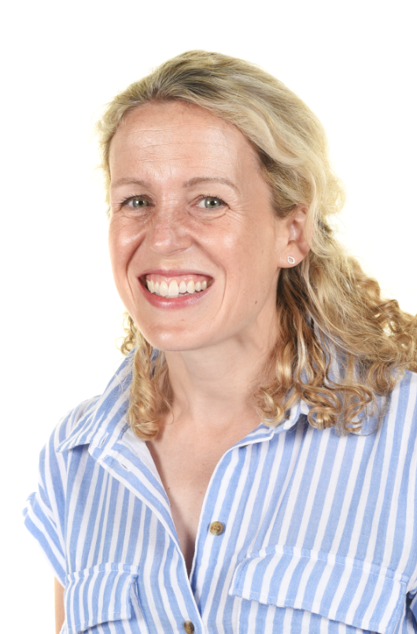
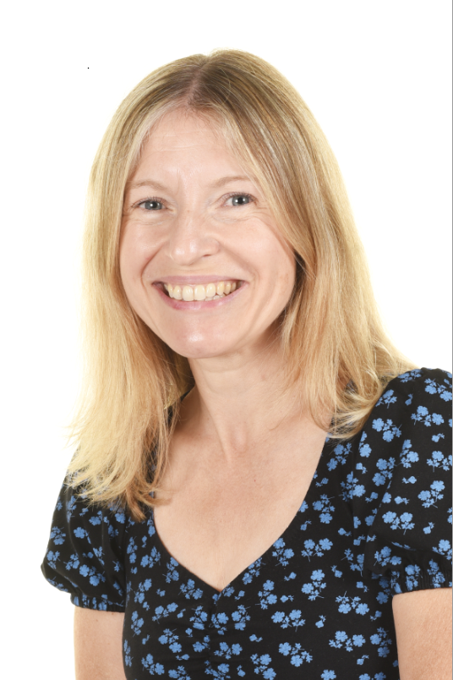
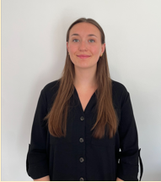
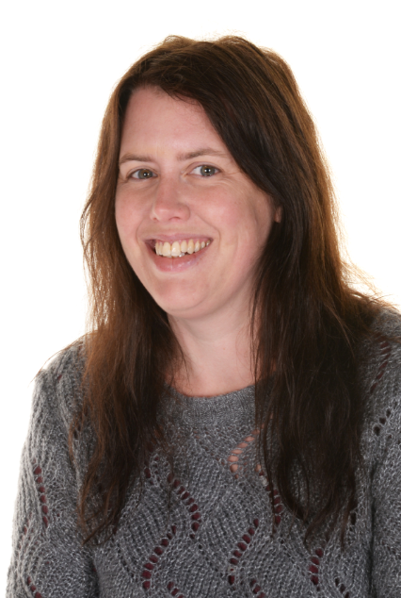
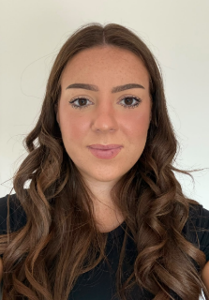
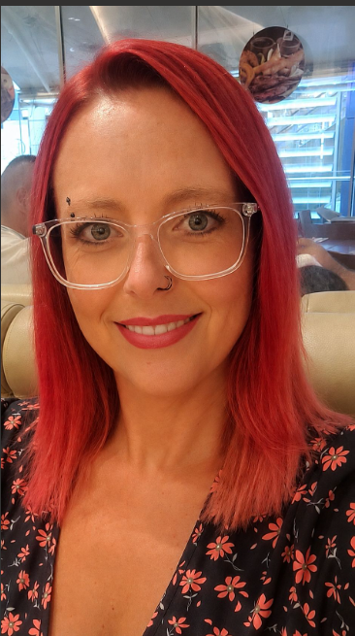
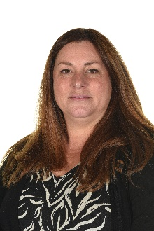
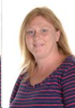
Who teaches your children?
Owl Class is taught by Miss Milne (Mon-Wed) and Mrs Smith (Thurs and Fri).
Jay Class is taught by Miss Gibson
Learning Partners: Mrs Steed, Miss Blessitt, Miss Kirk and Mrs Smith.
PPA afternoons alternate between a Tuesday and Friday. This is mandatory Planning, Preparation and Assessment time. These afternoons will be taught by Mrs Smith and Mrs Chandler on a Tuesday and Miss Milne and Mrs Chandler on a Friday.

Slide 3

In Year 3, in line with the rest of the school, we do things ‘The Golden Valley Way’
Our expectations are consistent across the school, and are derived from the principle of being Ready, Respectful and Safe.
‘Wonderful walking’
‘Wonderful listening’
Sharing Kindness, Challenging Ourselves and Others, and Achieving Excellence.

Slide 4
Core subjects - Reading, Writing, Maths and Science

Slide 5
Reading
In Y3 the main focus is to further develop the habit of reading for pleasure and fluency.
Some children have books matched to an Unlocking Letters and Sounds phonics phase as they have a few little gaps to secure to enable them to become fluent readers. These children will have daily reading sessions to address these gaps. Most children have now secured these gaps and are ‘free readers’.
Children are encouraged to record the things they have read (including functional reading such as instructions, recipes) in their reading records. It is important to try to read at home at least 3-4 times a week.
Whole Class Reading happens once a week. This has a comprehension focus – retrieval, prediction and inference.
In addition to this, we teach Unlocking Fluency as a whole class three times a week. This has a focus on prosody, vocabulary and automaticity by repeatedly reading a short text.

Slide 6
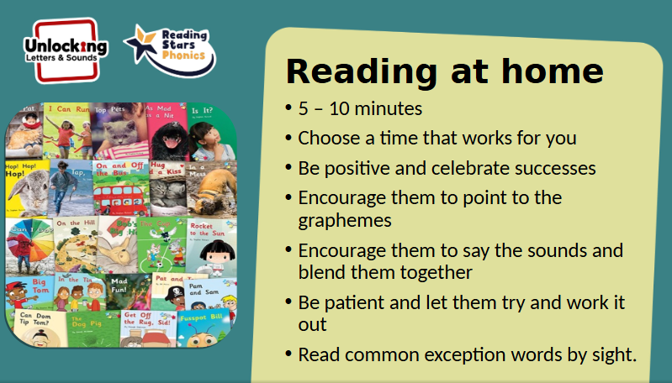
Best practice

Slide 7
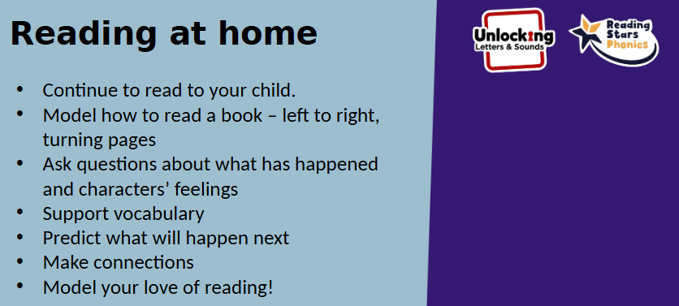

Slide 8
It is important to try to read at home at least 3-4 times a week.
How 10 minutes of daily reading helps:
Builds a strong foundation for literacy:
Reading to (and with) children early and often lays the groundwork for language skills and a love of learning.
Boosts vocabulary and comprehension:
Consistent exposure to books helps children acquire new words and understand stories.
Enhances cognitive skills:
Daily reading can improve a child's ability to think, remember, and reason.
Increases focus:
The habit of sitting and paying attention while reading can improve concentration and listening skills.
Develops empathy and well-being:
Reading helps children understand different perspectives, which can lead to greater empathy and a positive mood.
Fosters a love for reading:
Children who see parents reading and enjoying it are more likely to become lifelong readers themselves. ”
It also fosters independence as children can read instructions and texts by themselves, allowing them to access the wider curriculum more successfully.
Additionally, the more children read, the better writers they become.

Slide 9


Writing
We teach writing in our English lessons using quality texts.
This term we have read Stone Age Boy in support of our history curriculum and we are currently reading The Secret of Black Rock.
Separate, explicit lessons of spelling rules and cursive handwriting, which is a Year 3 expectation, are taught using our Unlocking Letters and Sounds programme.
Spelling is taught three times a week with two follow up tasks, one of which will be sent home as homework on a Friday to consolidate the spelling rule that they have learnt that week. Please return homework by Wednesday of the following week.
Grammar is mainly taught in context so that it can be applied meaningfully and elements are revisited within the unit of writing and during the year.

Slide 10
Maths
The White Rose Maths Scheme is used throughout Golden Valley.
The main principle is to develop depth of understanding and the ability to apply number skills to reasoning activities.
We also teach daily number fluency to aid rapid recall of number facts and strategies which aids children in their ability to apply reasoning to multi-step number problems.

Slide 11
Science
We follow the National Curriculum Programmes of Study.
This year your child will learn Y3 objectives about the skeletal system, nutrition, rock formation, friction and magnetism, flowering plants and light.
Computing
We use Purple Mash to cover the ever changing aspects of technology and coding. Your child has a login for this which is in the front of their reading record – do log in and explore this site as it has lots of fun and interesting activities.

Slide 12
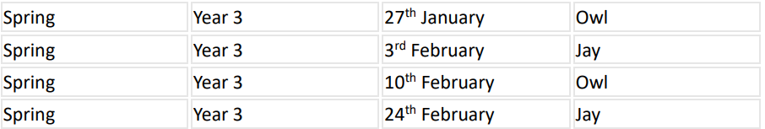
Forest School

Slide 13
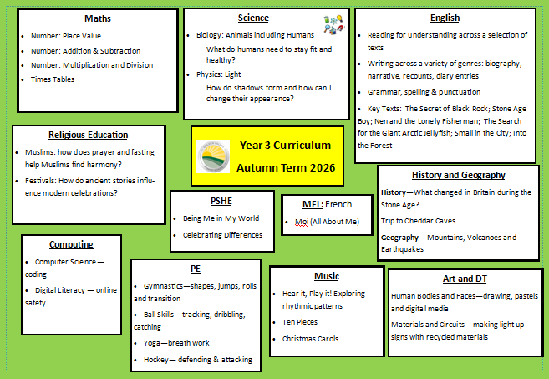

Slide 14

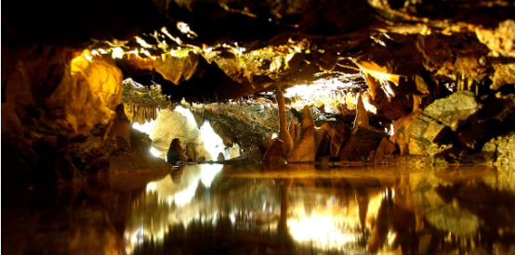
Date for your diary!
Year 3 school trip on Thursday 1st October to Cheddar Caves.

Slide 15
Every day items to have in school....
Water bottles
Rain coat
Fruit snack
Reading books and reading records in school every day please
Please make sure uniform is named
PE kits on a Wednesday (outdoor so trainers required) and a Friday (indoor)

Slide 16
Newsletter and Website
Please do read the weekly newsletter that is sent out to you. It will have information about the school community including important dates for your diary.
You can also find school information such as curriculum outlines and term dates on our website.

Slide 17
Thank you for coming

