Slide 1


Welcome to Year 5
Parent Information Meeting, Wednesday 23rd September 2026

Slide 2
Adults who work with your child
Nightingale Class | Woodpecker Class
Class Teacher Miss C Keen | Class Teacher Miss S Penny
LPs Mrs Lamb Mrs Milnes Ms Clark Ms Smith
Miss Somerville covers PPA time (Wednesday PM) Mrs Pye teaches Woodpeckers on a Friday (Week B)

Slide 3
PE Timetable
Week A and Week B
Monday and Wednesday

Slide 4
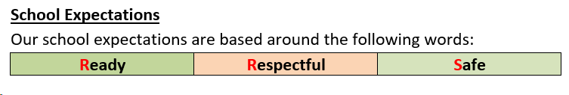
School Expectations
School Values
Sharing Kindness | Challenging Ourselves and Others | Achieving Excellence

Slide 5
In Year 5, we aim to…
Be happy at school.
Push ourselves and not give up.
Become increasingly independent learners.
Respect others and take responsibility for the choices we make.
Develop our oracy skills.
Develop good learning habits.
Try new things and not give up.

Slide 6
Trips and Workshops
Currently planning our trips and workshops for this year:
  Trip to M Shed
  Year 5 will do Bikeability in Term 4 (previously done in Year 6).
We are in the process of planning a second trip for this year.
We will be visited by the Explorer Dome in Term 3 to link with our Space unit in Science.

Slide 7

Reading Records (‘Fish’ Books!)
Reading Records are needed in school every day and we encourage the children to look after them.
Children are encouraged to record important dates in them at the start of the week.
Please comment if you have read with your child during the week.
We will record if your child has read individually with an adult in school.
Children have two reading fluency session each week and those children that need extra support have an additional session as well as one to one reading opportunities. There is also have a one hour reading comprehension lesson each week. These won’t be recorded in your child’s ‘Fish’ Book.

Slide 8
Homework
Each week we set English and Maths homework, assigned as pages from their homework books.
Homework is due in the following Wednesday and we do check to see if children have done this on time.
Please encourage your child to take pride in how they complete their homework – presentation matters!
If your child is struggling with their homework, please let us know and we will be able to support in school.

Slide 9


How you can support your child at home
Regular reading – at least four times a week.
Reading regularly for pleasure has been shown to improve a child’s life chances and supports their learning and development across the curriculum.
Fluent and confident knowledge of times tables makes it much easier for children to access the Maths curriculum, especially in Year 5 and 6

Slide 10
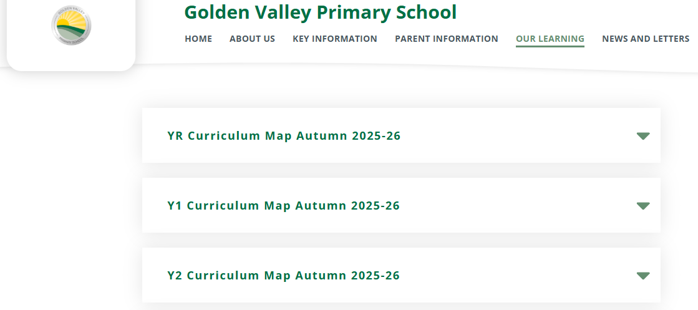
Year 5 Curriculum
https://www.goldenvalleyschool.co.uk/page/?title=Curriculum&pid=189

Slide 11
Communication
For medical appointments, attendance etc. please contact the School Office.
Please contact your child’s teacher in the first instance for anything else – they should be your first port of call.
We can be contacted face-to-face at drop off/pick up, email via the Office or leave a message and we can call you back.
Please be aware it may take up to two working days for us to respond.

Slide 12
Assessing your child’s progress
Children are formally assessed against a series of statements in Maths, Reading and Writing.
Progress in other subjects is monitored and assessed against National Curriculum objectives.
Throughout the year, the children’s progress is assessed by their teacher and next steps are carefully planned.
In Spring 2 and Summer 2, the children complete more formalised assessments (marked by us) which helps inform the teacher assessment.
At the end of the year, children are assessed in reading, writing and Maths using the following statements: working towards the expected standard (emerging); working at the expected standard (expected); working above the expected standard (Greater Depth).

Slide 13

Health
Fresh fruit for snacks please
Water bottles
Inhalers and allergies
Being excused from PE
Notes:
Children may not share snacks
Water only
Healthy snacks – keep separate from packed lunch if possible
No nuts – including Nutella (we have children with severe allergies in our year group)

Slide 14
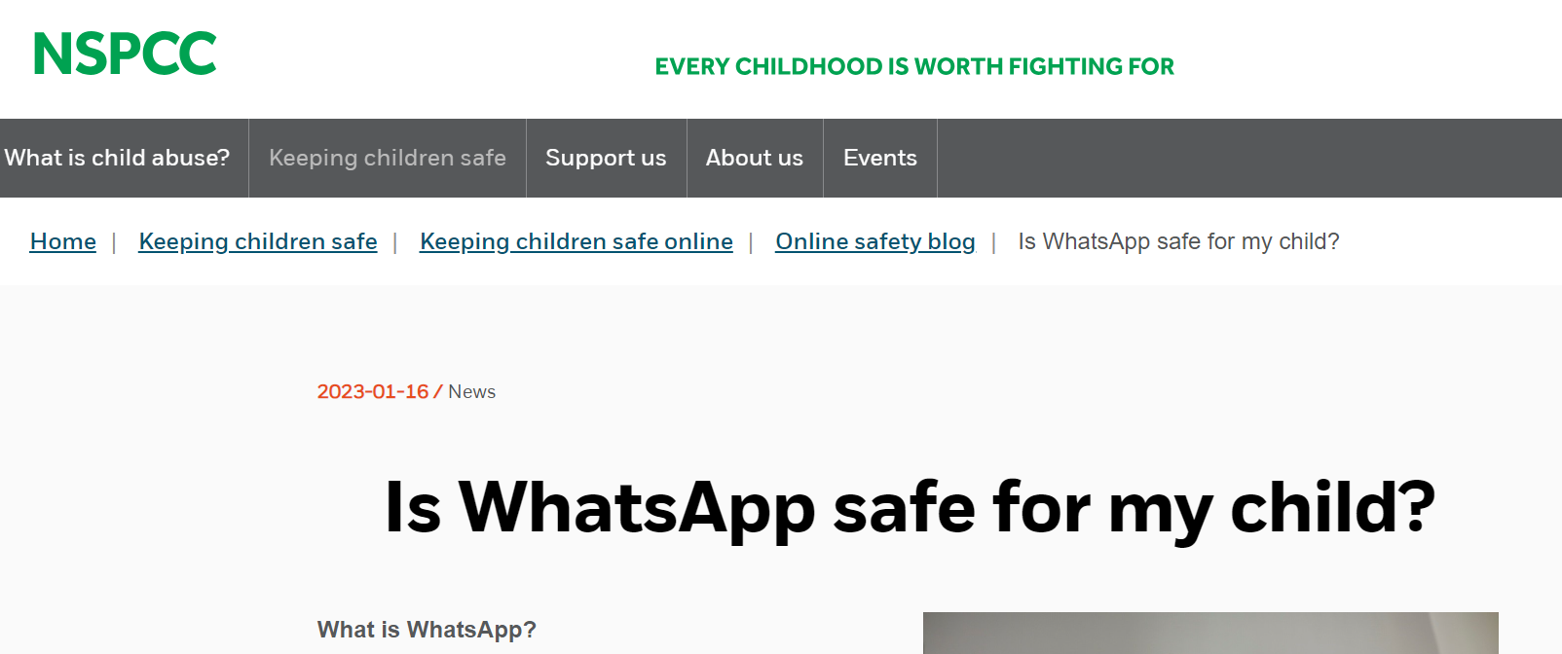

Personal belongings and safety
Please ensure everything is named!
Uniform and school bags
Walking home – please inform the office
Mobile phones
Online safety

Slide 15
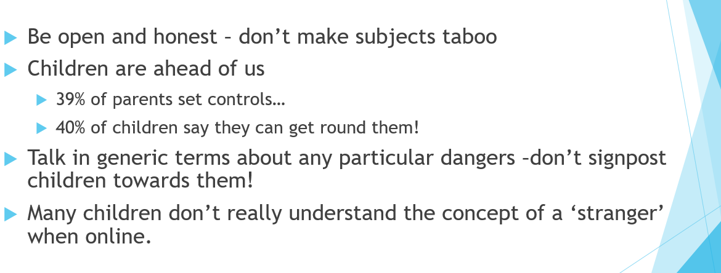

Slide 16


